Slide 1

Python for Data Science Advanced

Slide 2
Introductions
Training, materials, trainer

Slide 3
Program
Part 1 Machine Learning
Part 2 Regression
Part 3 Optimalization
Part 4 Classification
Part 5 Neural Networks
Part 6 Unsupervised Learning
Additional Reinforcement Learning
Notes:
1 PART = ongeveer een dagdeel

Slide 4
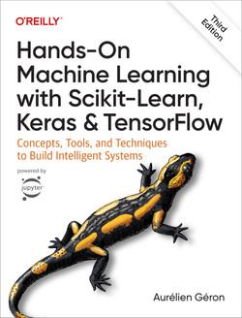
Material

Slide 5
Hello World
Tessel Haagen
BSc. & MSc. Artificial Intelligence and Computer Science
IT Teacher & AI Engineer
Harry Potter Fan

Slide 6

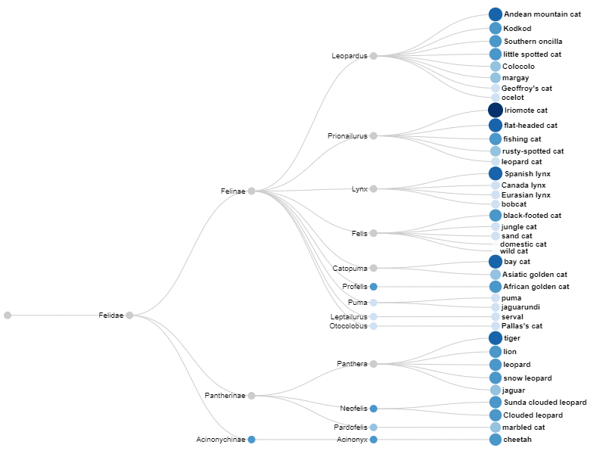
Materials
Exercises & slides on E-Connect
Examples from class and my personal favourite sources: https://github.com/TesselHaagen/DataScience-Advanced-11-2024

Slide 7
Part 1
Introduction to Machine Learning

Slide 8
Tools of the Trade
Python3
Libraries
Anaconda (optional)
Jupyter Notebook
IPython
Integrated Development Environments:
Spyder
PyCharm
Visual Studio Code
Choose your fighter!
Tip: start your IDE in administrator mode if you are on Windows, the installations sometimes require additional permissions.
Numpy
Scipy
Statsmodels
Pandas
Matplotlib
Seaborn
Plotly
Scikit-Learn
TensorFlow
Keras
PyTorch
Notes:
There are several different development environments available. All come with their own advantages and disadvantages and most are very easily customizable with plugins. Features like code cell execution and the variable explorer can be very useful for scientific analysis. However, those same features might hinder production, which could require a different development environment entirely.

Slide 9
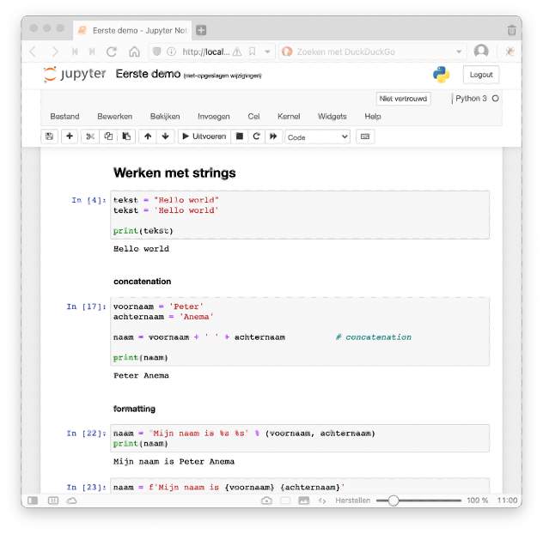
Jupyter Notebook
$ jupyter notebook
Web-based
Interactive computational environment where you can combine code execution, text, mathematics, plots and more
Why (not)?
+ Code documentation & examples
Running in cells
Slow development environment
Not production-ready
Notes:
Jupyter notebook is not used in the course

Slide 10

Data Science Pipeline
Reporting and Visualization
Question
Data Modelling
Data
Preparation
Data Exploration
Data
Acquisition
Result
Notes:
As described in the book by Aurelien Geron, data visualization really is an essential component of the machine learning process. It can really be applied at any step. Visualization in this context means preparing visual results for presentation and reporting, not the supporting data visualization that will be used throughout the process.

Slide 11
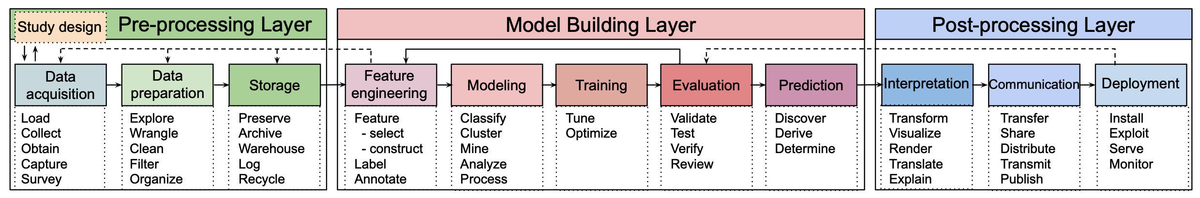
The Data Science Pipeline
Notes:
https://www.datascience-pm.com/crisp-dm-2/
https://design.cs.iastate.edu/papers/ICSE-22a/ds-pipeline-icse22.pdf
https://www.datascience-pm.com/data-science-workflow/
https://www.geeksforgeeks.org/kdd-process-in-data-mining/

Slide 12
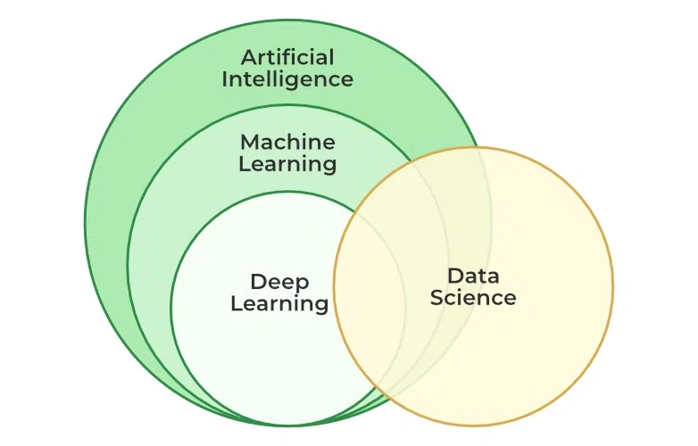
Machine Learning Checklist
Frame the problem -> big picture
Obtain/gather data
Explore the data to gain insights
Prepare the data
Explore different models
Fine-tune your models
Present your solution
Launch, monitor and maintain your system
Notes:
The data science process does not look much different from the machine learning checklist as proposed by Aurelie Geron, author of the book used in this course. Data Science has some overlap with the field of Artificial Intelligence, as both work with data a lot. While machine learning is a subfield of AI, it also has a lot to offer in the field of Data Science, where its algorithms can be used to model and analyse data. Throughout any process involving data, visualisation is a crucial tool to guide the process, for example using libraries like matplotlib and seaborn. The process of machine learning start with a look at the big picture. We need to determine which factors influence the environment. The next questions is how to get the data, as well as enough of it. Good quality data and sufficient quantity are both important to the learning process. Gathering data might be done through many means and there is information available on how to gather reliable crowdsourced data by comparing to expert labeling. The data will then need to be explored, to look at the distribution and possible values. The next step is data preparation and feature engineering. Almost all, if not all algorithms can not accept missing information, which means we will have to remove the data or provide a meaningful alternative. Large differences in scale between variables can also influence a machine learning model, which is why we might need to apply some scaling to our data as well. Machine learning algorithms only accept numerical values, so categorical features will also have to be prepared before modelling. This step is also where any dimensionality reduction occurs before we start the learning process. Some of these steps will already be familiar to data scientists. When the data is ready, you can apply multiple algorithms to develop some base models. You can compare different techniques on evaluation measures such as the accuracy (but that is not the only thing that matters, of course). After selecting one or more promising models the best meta/hyperparameters for each model can be determined, this is the fine-tuning process. After this step, if we have a viable model, we can present and/or report to stakeholders and move on to the launch of the system. After launch, especially in a system that continues learning, the system is monitored and maintained.

Slide 13
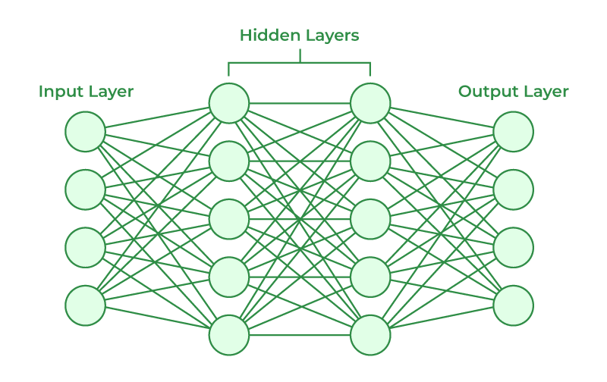
What are machine learning algorithms?
Tom Mitchell: “A computer program is said to learn from experience E with respect to some class of tasks T and performance measure P, if its performance at tasks in T, as measured by P, improves with experience E.”
In essence: learning from experience
Usually includes a hard to interpret ‘black box’
Notes:
Most algorithms also accept some sort of input, a black box (where lots of hard to understand numerical operations happen) and produce some kind of output. Tom Mitchell’s popular definition of machine learning is often cited and emphasizes the learning without explicit instruction (i.e. from experience).

Slide 14
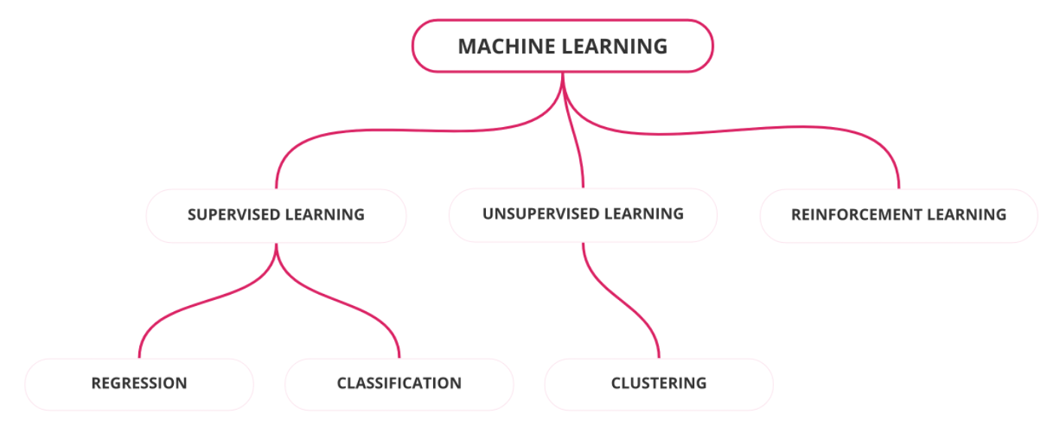
Machine Learning
Notes:
Machine learning algorithms can be roughly categorized into the following categories. This is a more simplified/traditional view that does not include semi-supervised learning tasks. Supervised learning tasks learn from a labeled dataset. They can be further divided into two subtasks: regression and classification. While the former tries to predict a continuous variable, the classification predicts a discrete variable. Unsupervised learning is different, because it does not include these labels. This means we can only cluster groups of datapoints according to their properties. The exact method, of course, depends on the clustering algorithm. Reinforcement learning is the last type of learning and usually does not include a dataset at all. This type of task is categorized by an agent that acts in their environment, based on some measure of utility (think score, speed, etc.). The agent starts in an initial state of the world and will experiment to develop behaviour that leads to rewards.

Slide 15
Machine Learning
Linear Regression
Support Vector Regression
Gaussian Proces Rregression
K-Nearest Neighbor
Decision Trees
Neural Networks
Ensemble Methodes
Notes:
Regression is the prediction of a continuous variable, so we are not limited to specific outputs. A few popular methods include Linear Regression, Support Vector Regression, Gaussian Process Regression and K-nearest neighbour. Decision trees can be used to predict values, but will contain a finite amount of leaves (and therefore values). We can also use ensemble methods to combine multiple regression models.

Slide 16
Machine Learning
Logistic Regression
Support Vector Machines
Discriminant Analysis
Naive Bayes
K-Nearest Neighbor
Decision Trees
Random Forest
Neural Networks
Ensemble Methodes
Notes:
Classification is the task of predicting a category, or class. This means our output options are limited. A few popular choices include Logistic Regression, Support Vector Machines (Support Vector Regression’s counterpart), Naive Bayes, K-Nearest Neighbour and Neural Networks. We can also combine multiple methods to optimize our machine learning system.

Slide 17

Machine Learning
K-Means
K-Median
Hierarchical
Gaussian Mixture
Neural Networks
Hidden Markov Model
Notes:
Finally we have a few different clustering methods, based on different similarity measures between data points.

Slide 18
Machine Learning
Linear Regression
Support Vector Regression
Gaussian Proces Rregression
K-Nearest Neighbor
Decision Trees
Neural Networks
Ensemble Methodes
Logistic Regression
Support Vector Machines
Discriminant Analysis
Naive Bayes
K-Nearest Neighbor
Decision Trees
Random Forest
Neural Networks
Ensemble Methodes
K-Means
K-Median
Hierarchical
Gaussian Mixture
Neural Networks
Hidden Markov Model
Neural networks are very universal!
Notes:
The neural networks, as you see, are a possibility for many different types of machine learning programs. We will learn more about them in the rest of the course.

Slide 19
Challenges of Machine Learning
Data Quality and Quantity:
Insufficient Quantity of Training Data
Nonrepresentative Training Data
Poor Quality Data
Irrelevant Features
Big Data
Challenges in Computation
Curse of Dimensionality
Computational Complexity
Model Training Issues
Overfitting the Training Data (variance)
Underfitting the Training Data (bias)
Ethical and Social Considerations
Transparency
Ethics

Slide 20

Computional Complexity
More input -> more resources needed
Feasability – Can it ever be computed?
Big O notation - Landau's symbol to denote algorithm complexity

Slide 21
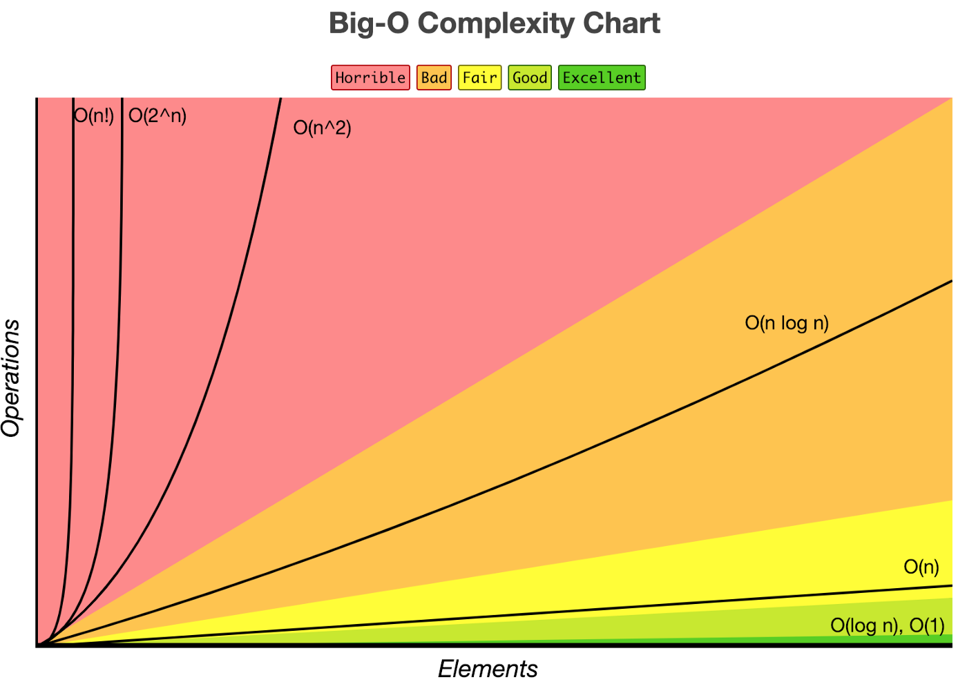
Big O Notation
Constant O(1)
Logarithmic O(log n)
Linear O(n)
Superlinear O(n log n)
Polynomial O(n^2)
Exponential O(2^n)
Factorial O(n!)
Notes:
https://medium.com/mlearning-ai/computational-complexity-of-machine-learning-algorithms-16e7ffcafa7d
https://www.bigocheatsheet.com
BIG O NOTATION EXAMPLE ALGORITHM
O(log n) Binary search
O(n) Simple search
O(n * log n) Quicksort
O(n2) Selection sort, Tower of Hanoi
O(n!) Traveling salesperson

Slide 22
Training and Test Sets
Split data before training
Independent training and test subsets
Training
Data
Preparation
Model Generation
Data
Test Data
Preprocessing
Model Evaluation
Unseen Data
Preprocessing
Model Prediction

Slide 23
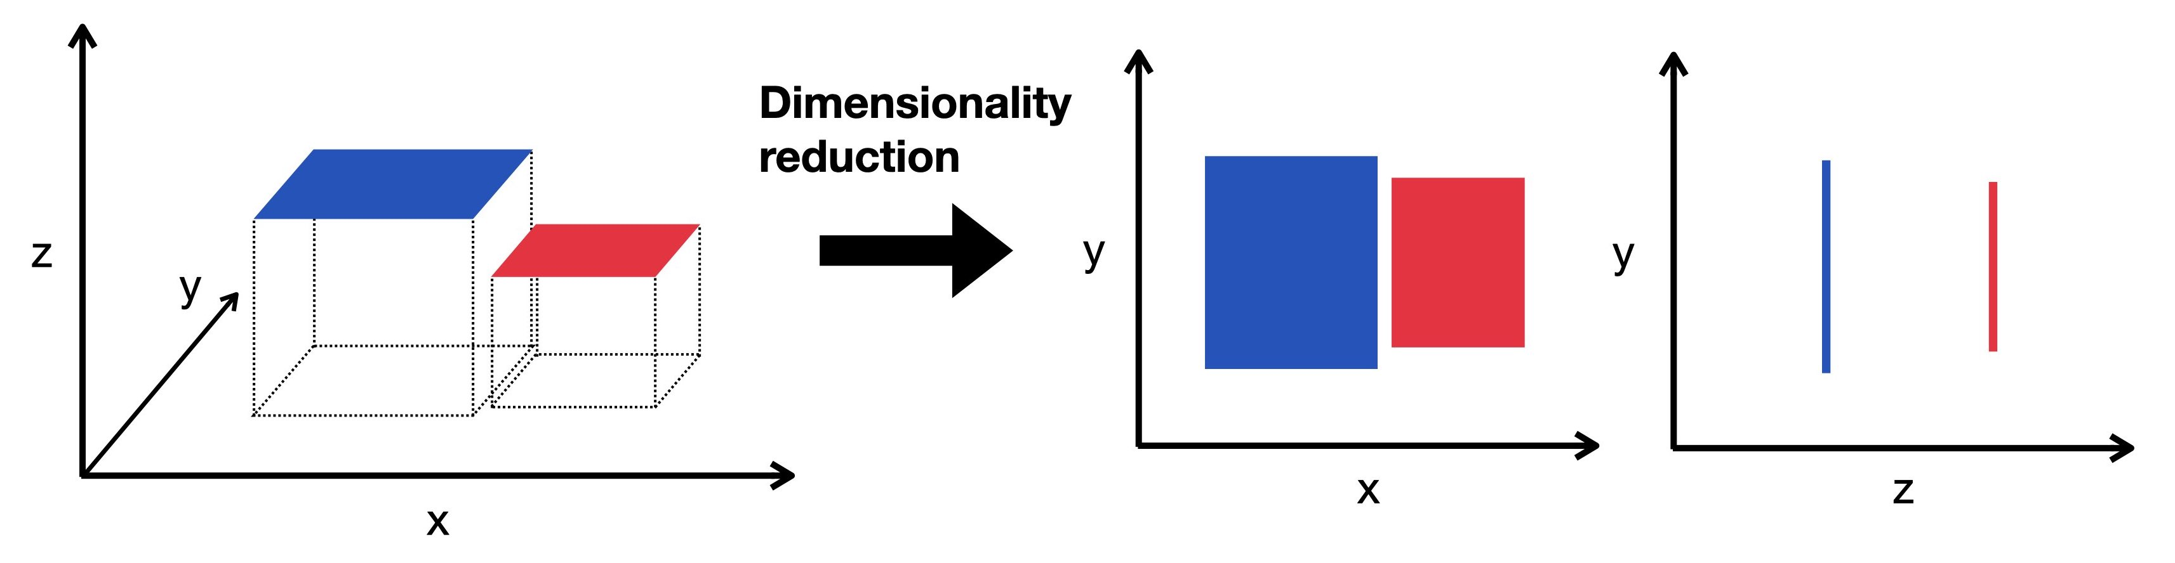
Data Preparation
Data Cleaning – Missing values, duplicates, incorrect values
Split training set and test set
Scaling numeric variables
Coding categorical variables
Feature Engineering / Selection
Dimensionality Reduction (including PCA)

Slide 24
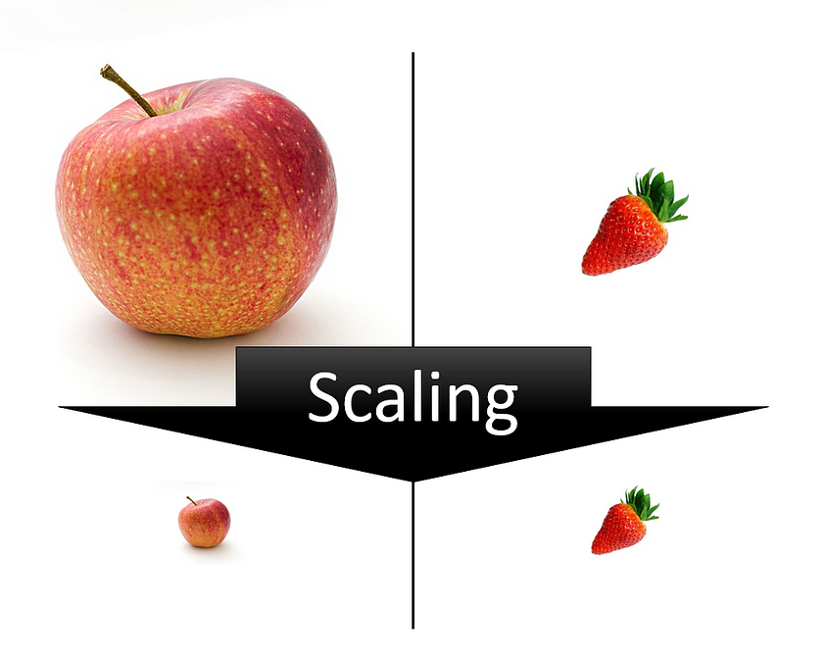
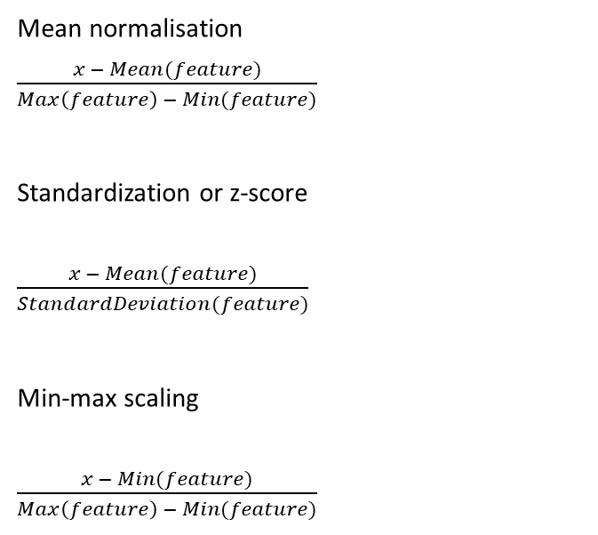
Scaling
Problem: many machine learning algorithms are impacted by large ranges of values
Mean normalisation $\frac{x − Mean(feature)}{Max\left(feature\right) − Min(feature)}$
Standardization or z-score $\frac{x − Mean(feature)}{StandardDeviation(feature)}$
Min-max scaling $\frac{x − Min(feature)}{Max\left(feature\right) − Min(feature)}$

Slide 25
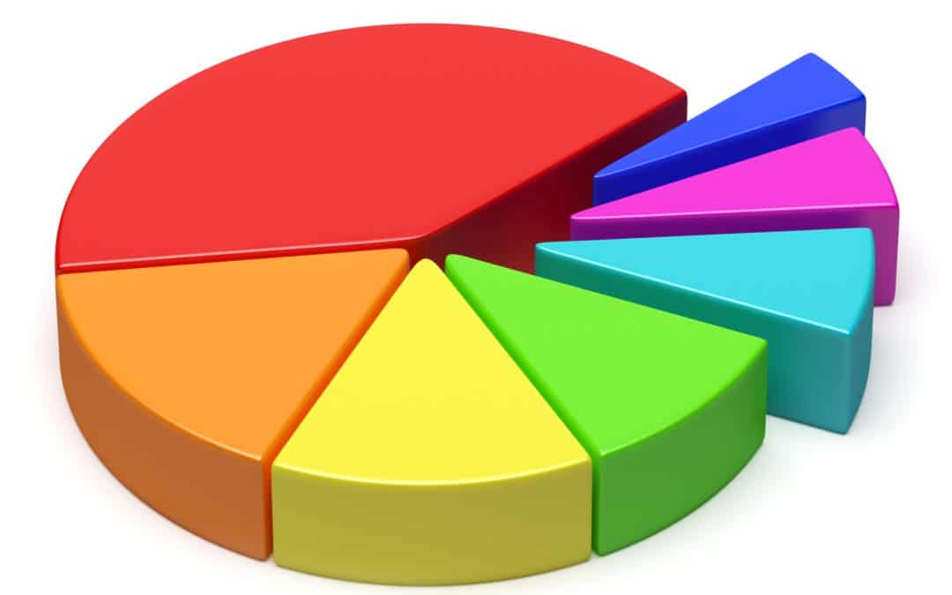
The categorical variable
Definition:
Data divided into multiple categories or labels (often strings in Computer Science).
Examples:
Hair color (usually “blonde”, “red”, “brown”, etc.)
Some grading systems
Rankings (think tournament)
But: computers & algorithms much prefer numerical values

Slide 26
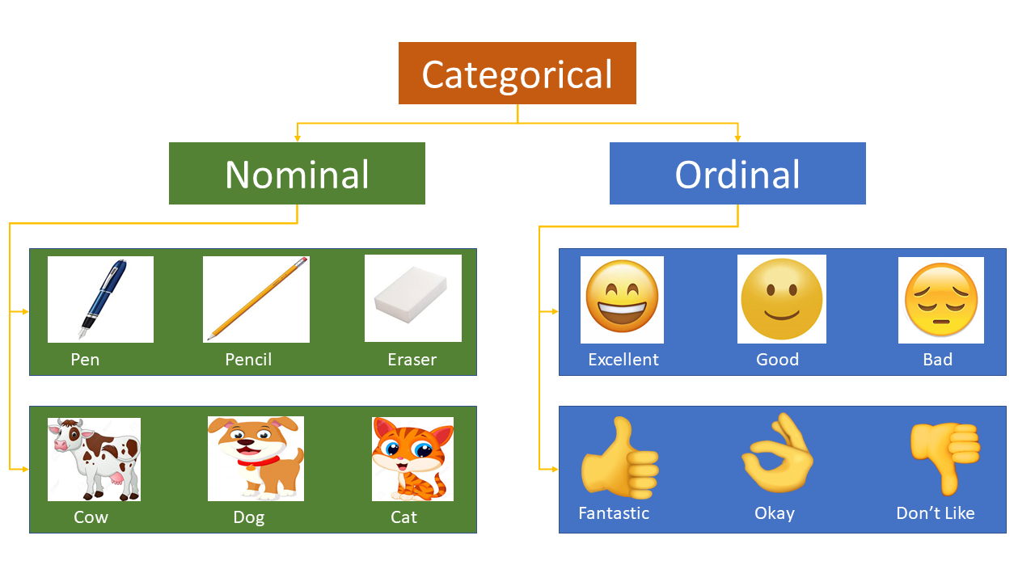
Categorical variables: nominal vs. ordinal
This distinction tells us more about the relationship between different possible values

Slide 27
Categorical Variables – Label encoding
Label coding is assigning a number to each possible value
Example: coding a category of
Implies a linear relation (ordinal relationship)
-> if the number is twice as big, then the category is twice as big
What does that mean for encoding?
Item_Category
Fitness
Food
Kitchen
Food
Item_Code
1
2
3
2
Performance
Very poor
Poor
Average
Good
Excellent
Performance_code
1
2
3
4
5
Note: this still only works if we can quantify the difference between these different labels

Slide 28
Categorical Variables – One Hot Enc.
Another option:
One-hot encoding
Adds a feature for every possible value in the category (dummy column)
Dummy Variable Trap (highly correlated variables encoded separately)
Curse of dimensionality
Item_Category
Fitness
Food
Kitchen
Food
Fitness | Food | Kitchen
1 | 0 | 0
0 | 1 | 0
0 | 0 | 1
0 | 1 | 0
Food for thought: are any of these categories related? How can we capture similarity?
Notes:
A more widely used option for encoding categorical variables

Slide 29
Statistical Metrics for data insight
Next step: gather insights
Central measures/measures of central tendency
Mean
Median
Mode
Measures of dispersion/measures of variability
Variance
Standard deviation
Inter Quantile Distance
Skewness
Symmetrical/asymmetrical distributions
Positively or negatively skewed
Notes:
Nederlands: centrummaten, spreidingsmaten en scheefheid van de verdeling

Slide 30
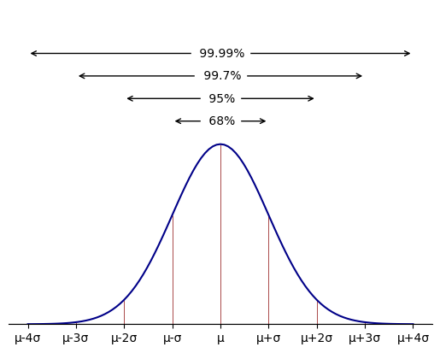
Normal Distribution
Notes:
https://towardsdatascience.com/6-ways-to-test-for-a-normal-distribution-which-one-to-use-9dcf47d8fa93

Slide 31
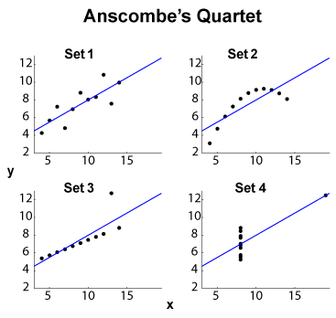
Testing for Normality
Preferrably normality is assessed both visually and through normality tests
Histogram
Boxplot
QQ Plot
Shapiro Wilk test (highly recommended)
Kolmogorov Smirnov test
Lilliefors test
Notes:
https://towardsdatascience.com/6-ways-to-test-for-a-normal-distribution-which-one-to-use-9dcf47d8fa93
https://towardsdatascience.com/choose-the-appropriate-normality-test-d53146ca1f1c
https://www.statology.org/normality-test-python/
https://pyshark.com/test-for-normality-using-python/
Anscombe's Quartet
Datasourus dataset

Slide 32
Binominal Distribution

Slide 33
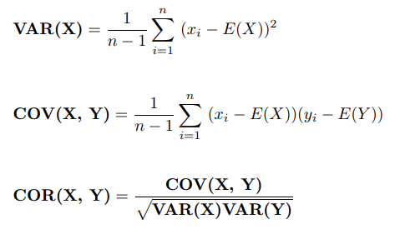
Correlation and Covariance
Both measure the linear relationship and the dependency between two variables
Covariance indicates the direction of the relationship
Correlation measures strength and direction of the relationship
Correlation is a function of the covariance
Correlation values are standardized whereas, covariance values are not standardized.

Slide 34
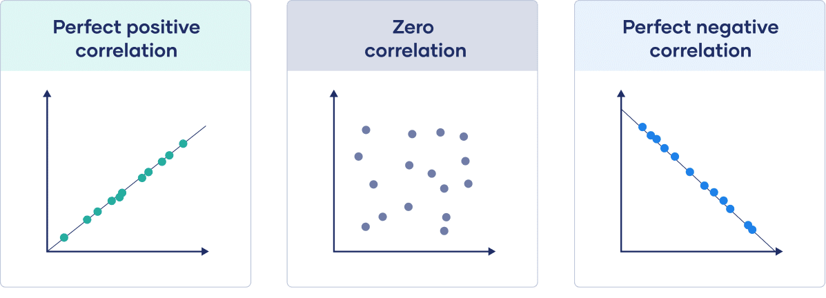
Correlation Coefficient
Pearson's Correlation Coefficient
Spearman's Correlation Coefficient

Slide 35
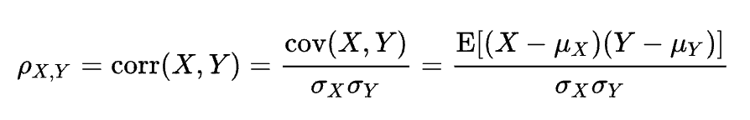
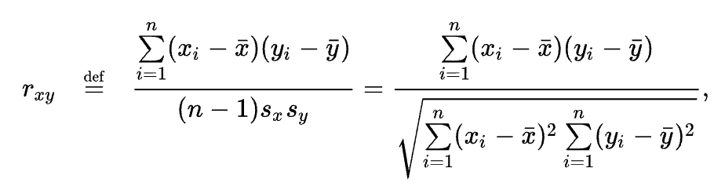
Correlation
Pearson product-moment correlation coefficient
Sample correlation coeficient:

Slide 36
Exercise: data insights
Download Pearson Father Son dataset (e.g. from Kaggle)
Import into a Pandas dataframe
Explore the dataset
How many columns and rows are there? What types of variables do we have?
Display histograms of the different column values: what do you think their distributions are?
Display scatter plot of height of a father versus height of a son
Calculate Pearson's correlation coefficient
Use a student t-test to prove if there is a difference between fathers and sons
This should all be pretty basic, but will form the foundation for our next exercise.

Slide 37
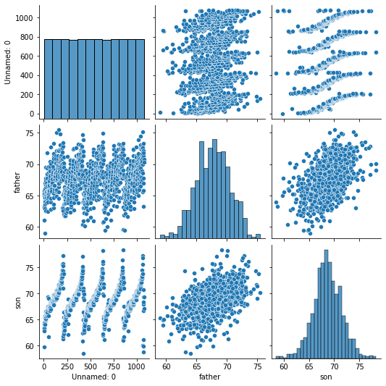
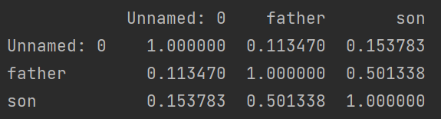
Pearson Father & Son results

Slide 38
Statistical Tests
Null hypothesis H0
Alternative hypothesis H⍺
Quantitive vs. Categorical data
Student T-test
Paired
Left, Right or Two Tailed
Chi-Squared test
ANOVA

Slide 39
Part 2
Regression Algorithms

Slide 40
Part 2 - Regression
The task is to predict a numerical value given a set of input values.
Linear Regression
Multiple Regression
Evaluation Metrics

Slide 41
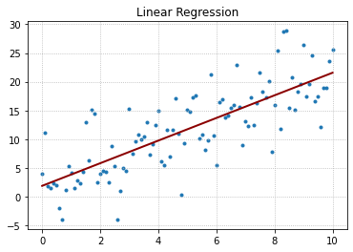
Linear Regression
Input features
Number of dimensions
Ordinary Least Squares (OLS) optimalisation of coefficients
-> minimizes MSE

Slide 42
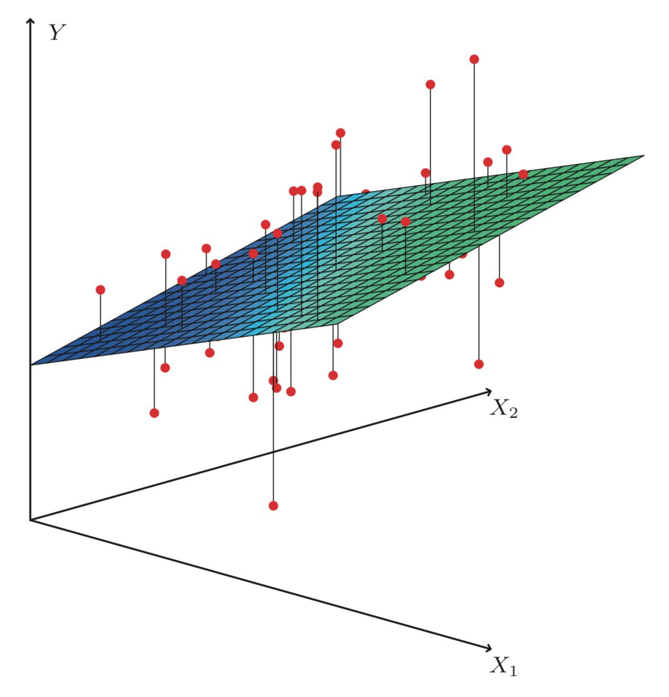
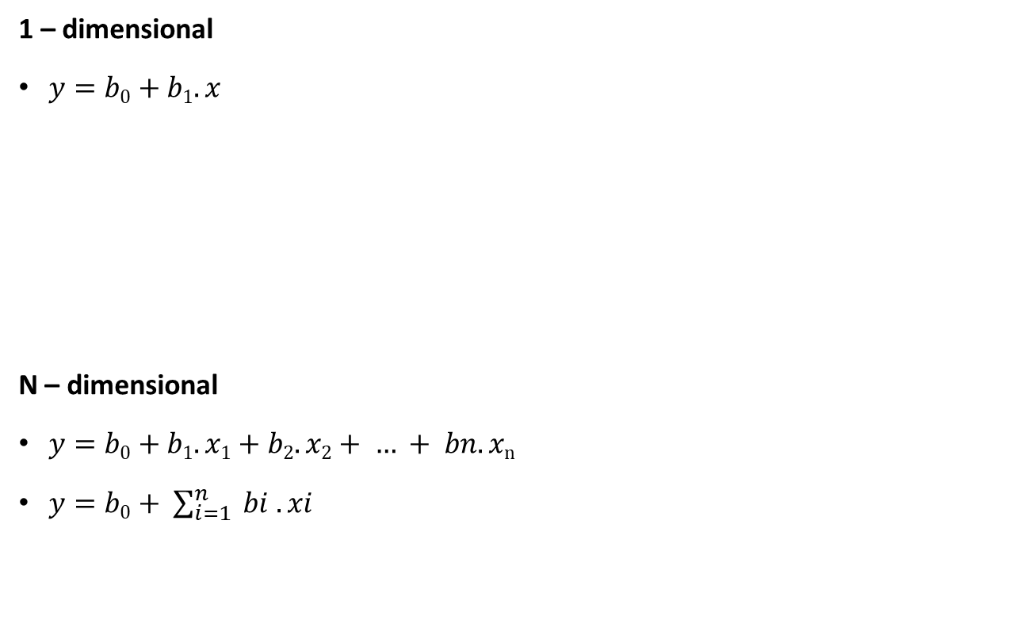
Linear Model
1 – dimensional
$y=b0+b1.x$
N – dimensional
$y=b0+b1.x1+b2.x2+ … + bn.xn$
$y=b0+ \sum_{i=1}^{n}{ bi . xi}$

Slide 43
Regression
Linear Regression
Multiple Regression
Non-linear Regression
Custum model optimalisation

Slide 44
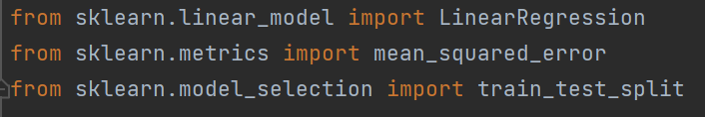
Exercise: linear regression (1 variable)
Continue from the previous exercise
Calculate the coefficients for the linear regression
Use scikit-learn (LinearRegression is the model)
Calculate the coefficients directly
Visualize the linear regression line using the coëfficients you found
Tip: you might need the following imports

Slide 45
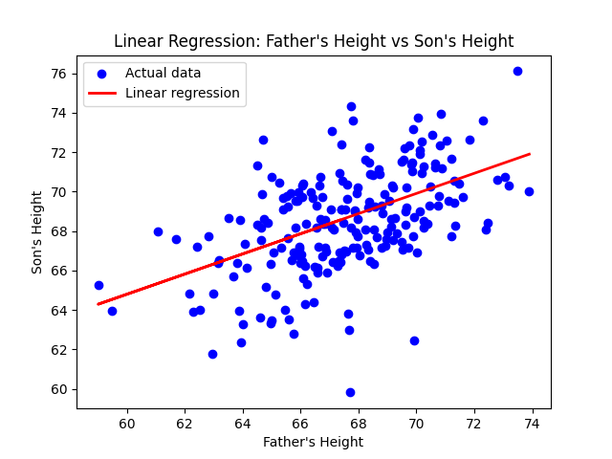
Linear Regression Results

Slide 46
Feature Engineering
Dimensionality Reduction
Principle Component Analysis
Feature Selection
Filter method
Wrapper Method
Embedded Method
Ridge
Lasso
ElasticNet

Slide 47
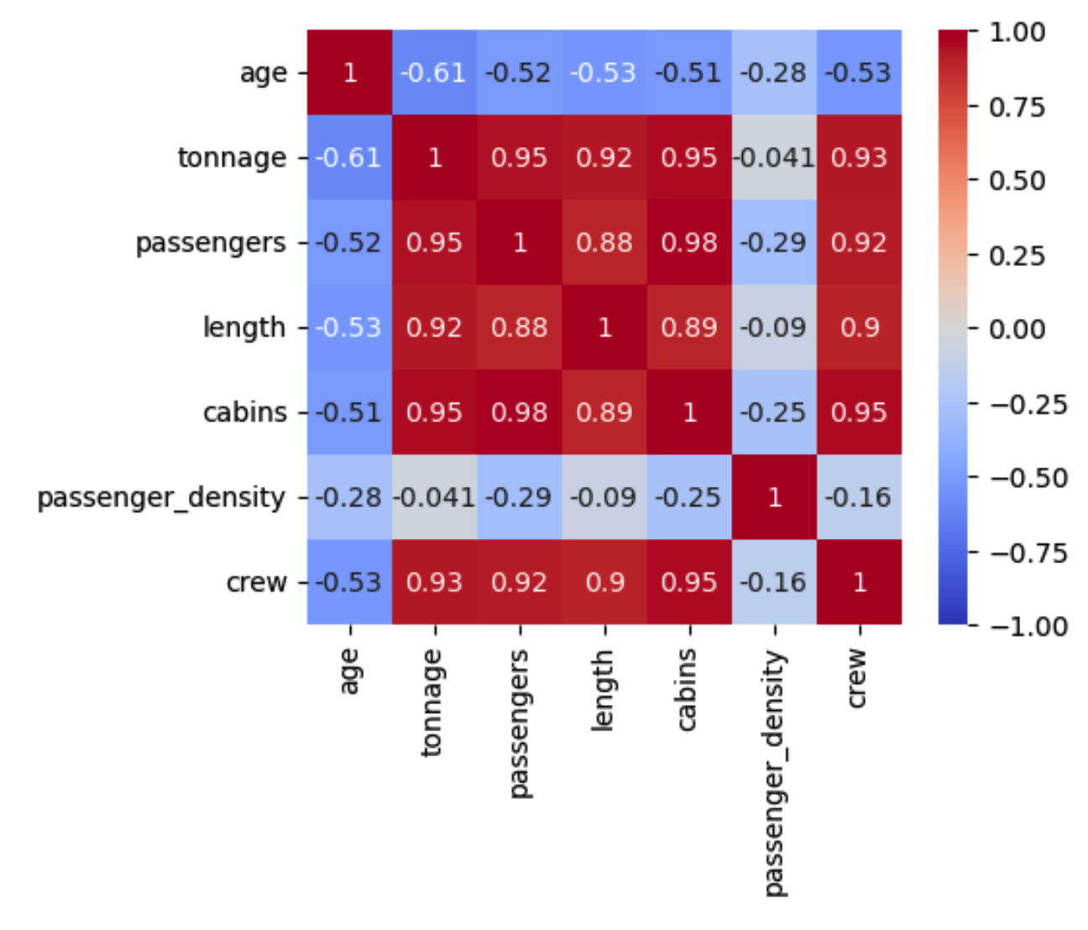
Correlation Matrix
Notes:
corr = df.corr()
corr \
.style \
.format(precision=2) \
.background_gradient(cmap='coolwarm', axis=None)
fig, ax = plt.subplots(figsize=(5, 4))
sns.heatmap(corr,
cmap = 'coolwarm',
vmin = -1,
vmax = 1,
square = True,
annot = True,
ax = ax)
plt.show()
from matplotlib.colors import LinearSegmentedColormap
cmap = LinearSegmentedColormap.from_list('RedGreenRed', ['crimson', lime', 'crimson'])

Slide 48
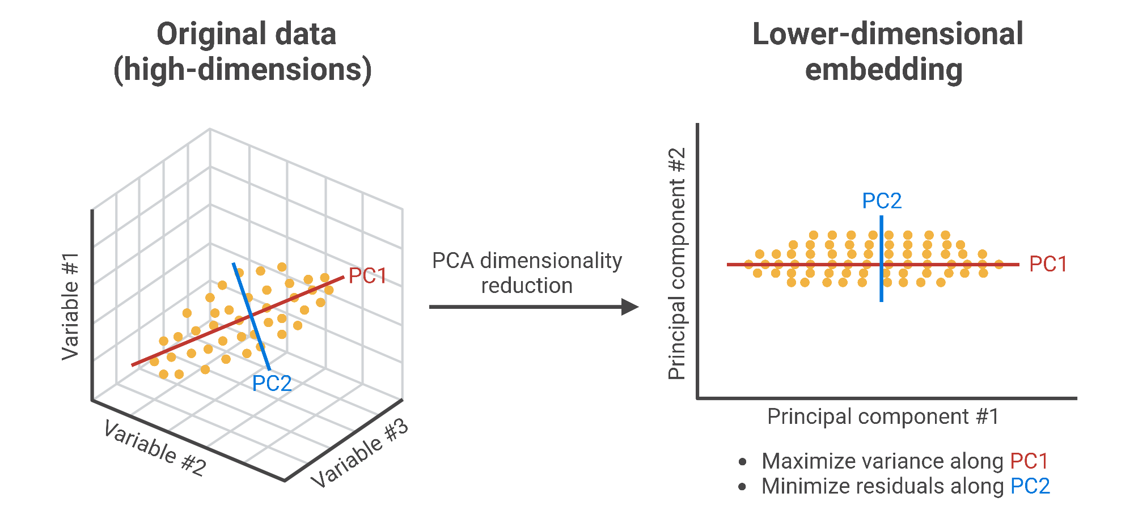
Principle Component Analysis

Slide 49
Regression algorithms
Linear regression
Multiple regression
Non-linear regression (exponential, polynomial)
Custom model optimalisation - Ordinary Least Squares
Regression
Linear Regression
Support Vector Regression
Gaussian Proces Rregression
K-Nearest Neighbor
Decision Trees
Neural Networks
Ensemble Methodes

Slide 50
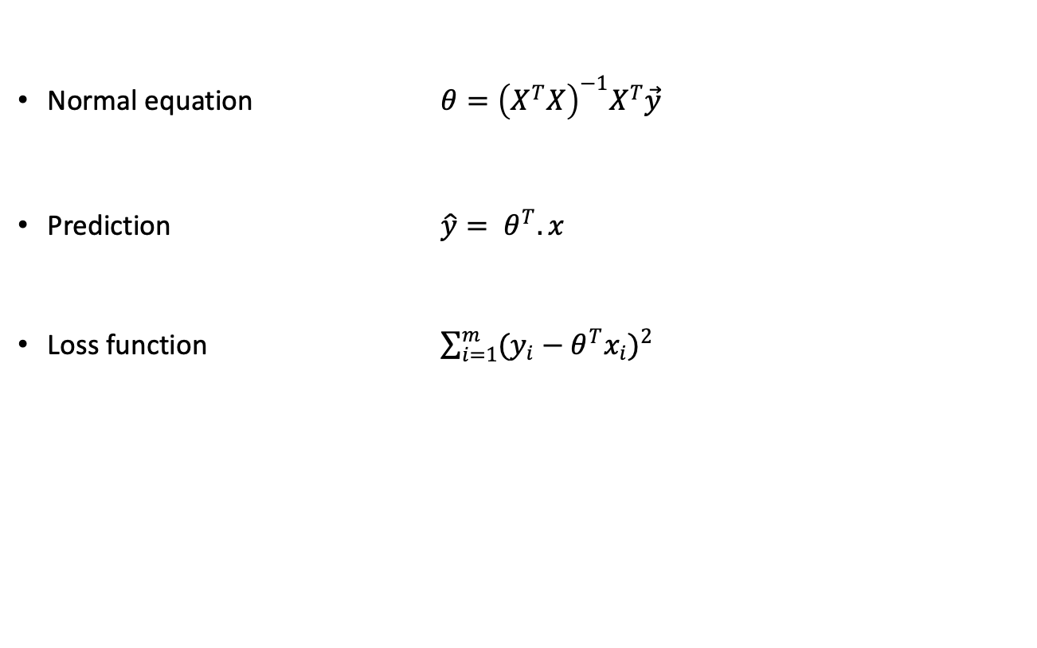
Closed Form Solution
Normal equation $θ={\left(X^{T}X\right)}^{−1}X^{T}\vec{y}$
Prediction $\hat{y}= θ^{T}.x$
Loss function $\sum_{i=1}^{m}{{(y_{i}−θ^{T}x_{i})}^{2}}$
Notes:
https://towardsdatascience.com/normal-equation-in-python-the-closed-form-solution-for-linear-regression-13df33f9ad71

Slide 51
Least Squares Linear Regression

Slide 52
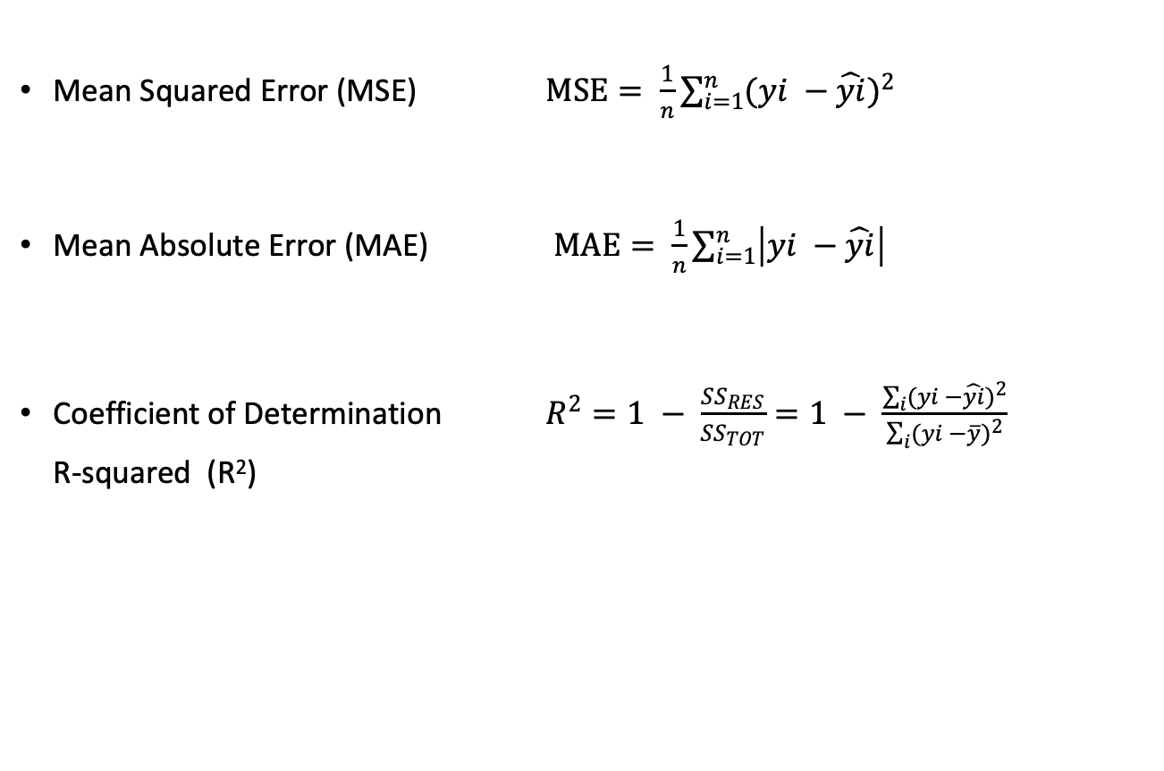
Evaluation Measures for Regression
Mean Squared Error (MSE) $MSE= \frac{1}{n}\sum_{i=1}^{n}{({yi −\hat{yi})}^{2}}$
Mean Absolute Error (MAE) $MAE= \frac{1}{n}\sum_{i=1}^{n}{\left|yi −\hat{yi}\right|}$
Coefficient of Determination $R^{2}=1 − \frac{{SS}_{RES}}{{SS}_{TOT}}=1 − \frac{\sum_{i}{({yi −\hat{yi})}^{2}}}{\sum_{i}{({yi −\overline{y})}^{2}}}$ R-squared (R²)

Slide 53
Linear Regression with Python
Numpy numpy.polyfit & numpy.poly1d numpy.linalg.lstsq
Scipy scipy.stats.linregress
Scikit-learn from sklearn.linear_model import LinearRegression
Optimalization
scipy.optimize.least_squares
scipy.optimize.curve_fit
Cost function
OLS – Ordinary Least Squares

Slide 54
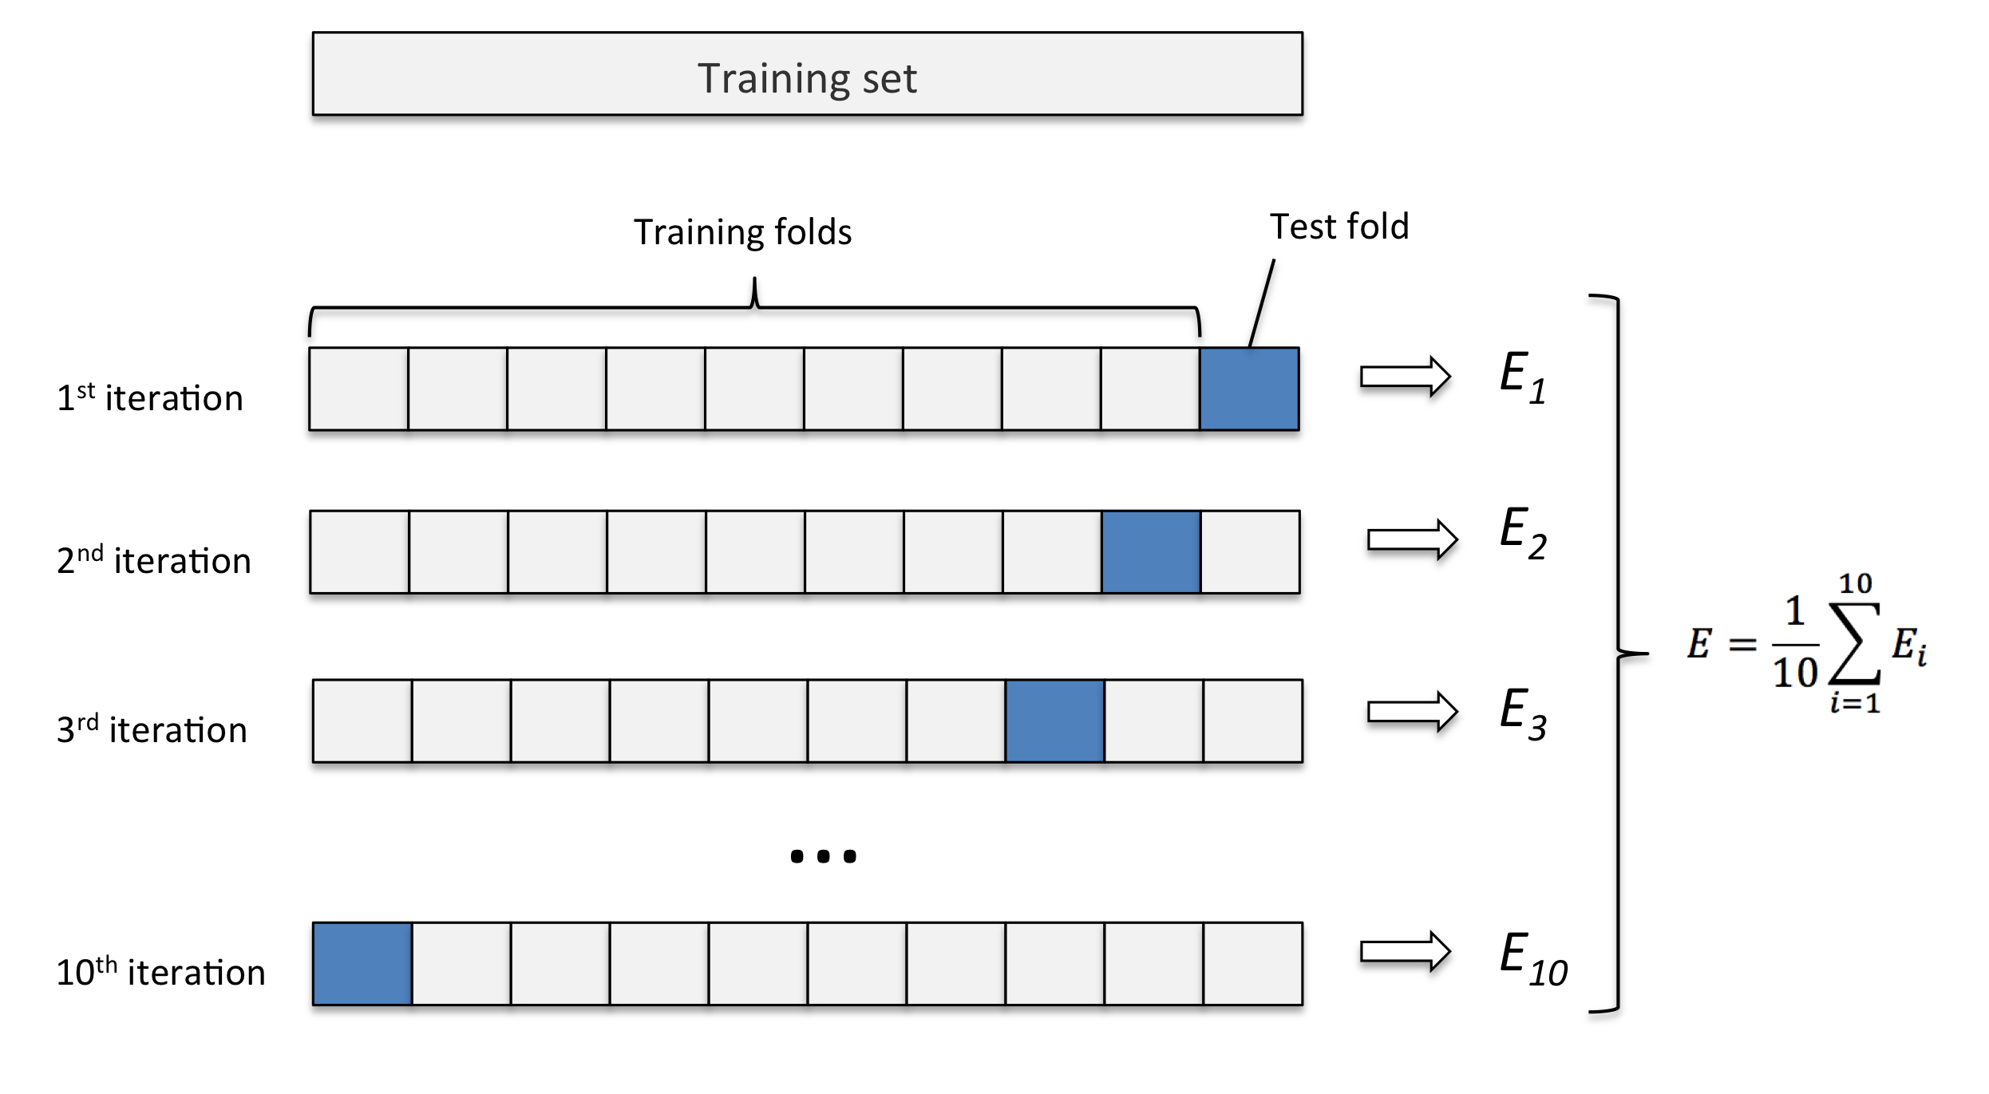
Cross-Validation
k-Fold
Notes:
https://www.statology.org/k-fold-cross-validation/

Slide 55


Let’s compare linear regression models
Implement a linear model as a function
Select a range of x values
Determine the corresponding y values
Add noise to the y values
Use numpy.polyfit to detrmine the linear regression coefficients
Do the same using scipy.curve_fit
Compare the results

Slide 56
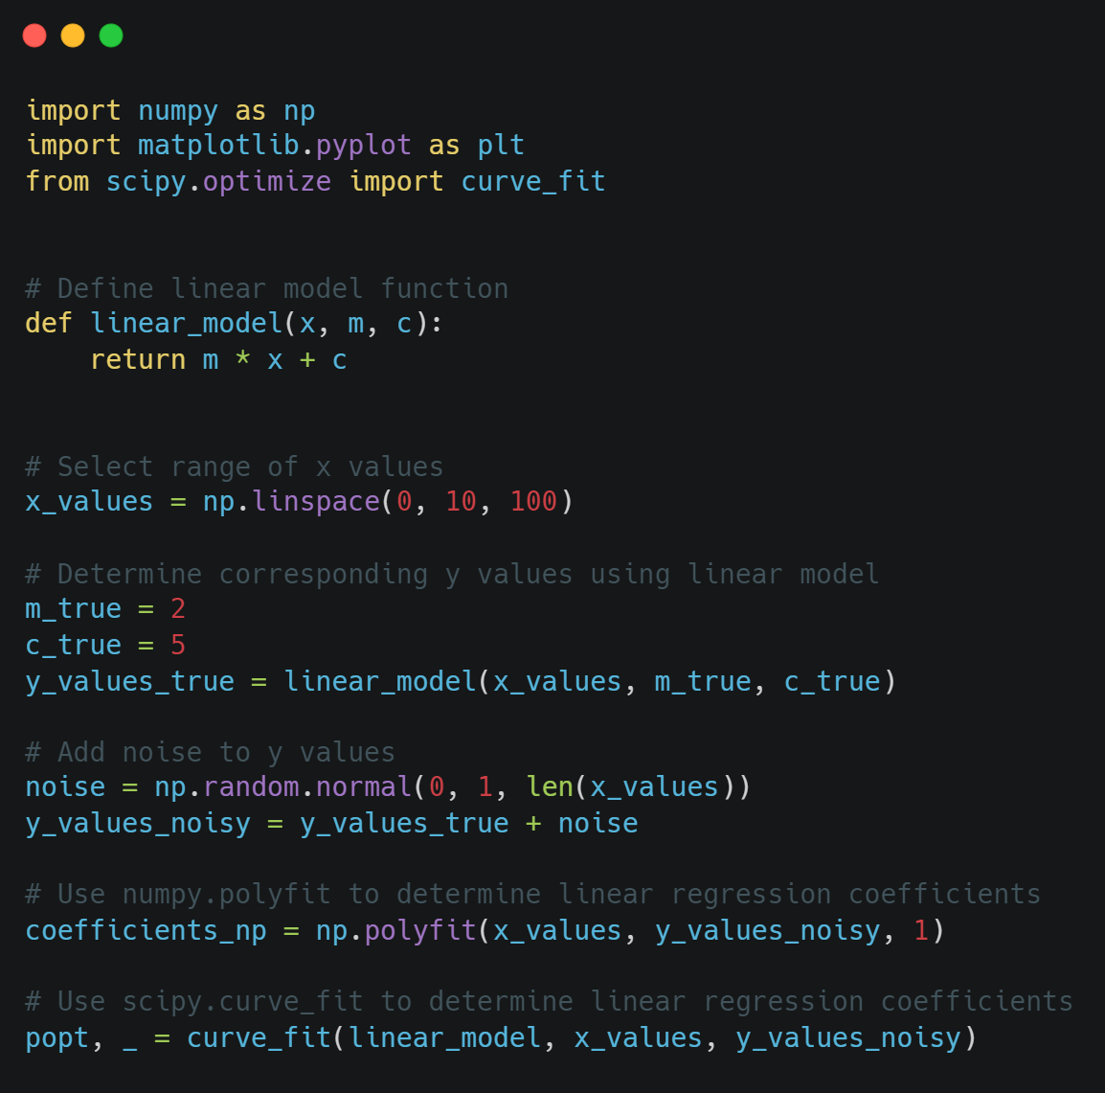
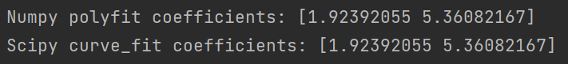
Demo comparison Numpy & Scipy

Slide 57

What if it doesn’t fit?
Machine learning is a trade off between bias and variance
Overfitting -> model does not generalize well
Bias -> model is too generalized

Slide 58
Lasso
Least Absolute Shrinkage and Selection Operator
Regression analysis method that performs variable selection and regularization
Generally improves prediction accuracy and interpretability of regression models
Selects a reduced set of the known covariates for use in a model
Parameter λ: controls shrinkage. Larger values increase shrinkage
Penalty called a shrinkage penalty is applied to encourage shrinking parameters to 0 (effectively eliminating them)
Notes:
https://en.wikipedia.org/wiki/Lasso_(statistics) It heavily relies on parameter λ, which is the controlling factor in shrinkage. The larger λ becomes, the more coefficients are reduced. When λ is equal to zero, then the model becomes the Ordinary Least Squares regression (because its effect is almost neglible). Consequently, when λ increases, the variance decreases significantly, and the bias in the result increases, too. Lasso is also a useful tool in eliminating all irrelevant variables that are not related to the response variable. e forced to be zero.
It's basically fit versus the size of the coefficients.
That penalty is called a shrinkage penalty because it's going to encourage the parameters to be shrunk toward 0.

Slide 59
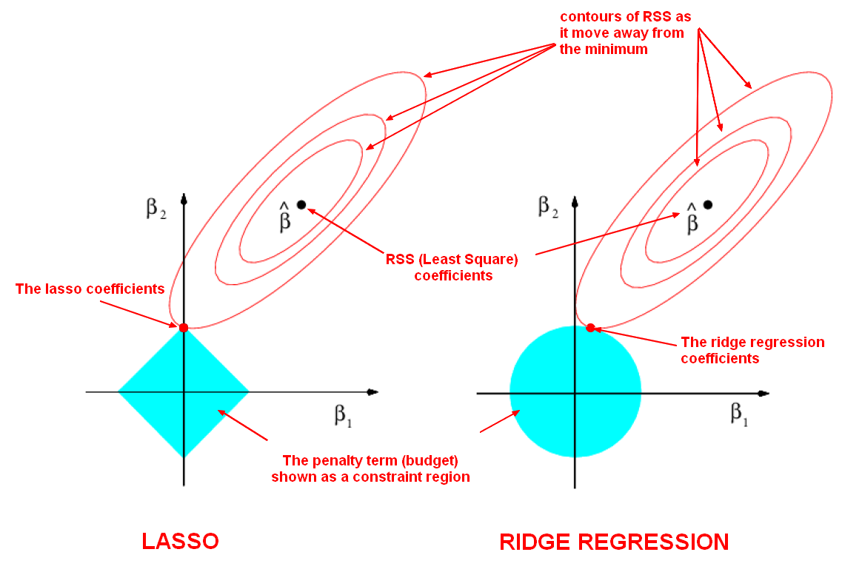
Regularization
Ridge Regression
Least Absolute Shrinkage and Selection Operator (LASSO)
Elastic Net
Least-Angle Regression (LARS)

Slide 60
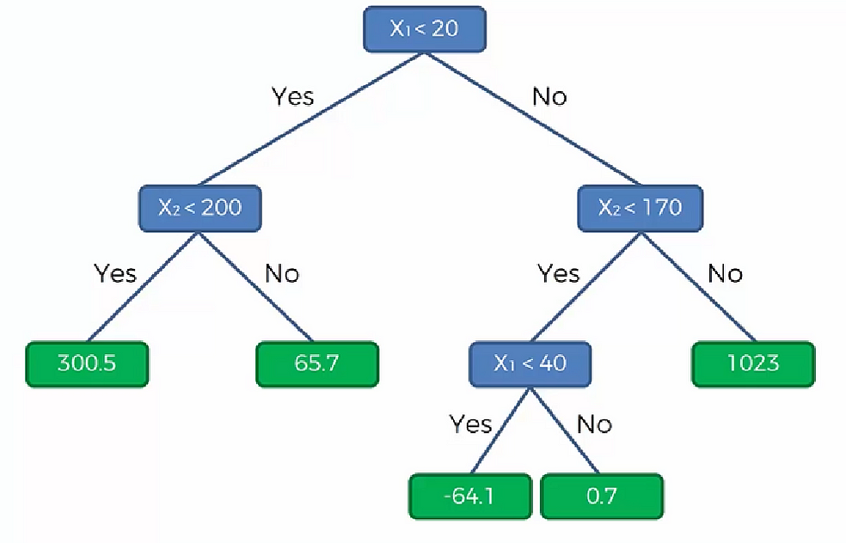
Other Regression Algorithms
Nearest Neighbor Regression
Decision Tree
Random Forest
Robust Regression — RANSAC
Gaussian process regression
Support Vector Regression
Many algorithms can be used for both
regression and classification
Notes:
https://towardsdatascience.com/7-of-the-most-commonly-used-regression-algorithms-and-how-to-choose-the-right-one-fc3c8890f9e3

Slide 61
Exercise: multiple linear regression
Use multiple linear regression to estimate the house price from the other features in the dataset.
Get the data from housing.csv.
Explore the data.
Clean the data. Remove missing values.
Prepare the data for modelling. Encode categorical variables and scale numerical variables. Determine target variable. Split in training and test sets.
Use scikit-learn to train a linear model with sklearn.linear_model.LinearRegression.
Evaluate the model by calculating various metrics (R squared, MSE, MAE).
Display the coefficients. What does this tell you?
Repeat the modeling with other models like Ridge, Lasso, ElasticNet.
Also build a model with RandomForestRegressor and display the feature importances.

Slide 62
Part 3
Optimalising your solutions

Slide 63
Part 3 - Optimalization
Cost Function
Least Squares Optimalisation
Gradient Descent
Monte Carlo
Notes:
https://machinelearningmastery.com/tour-of-optimization-algorithms/
https://en.wikipedia.org/wiki/Gradient_descent
https://medium.com/analytics-vidhya/optimization-algorithms-feb9dcb57116

Slide 64
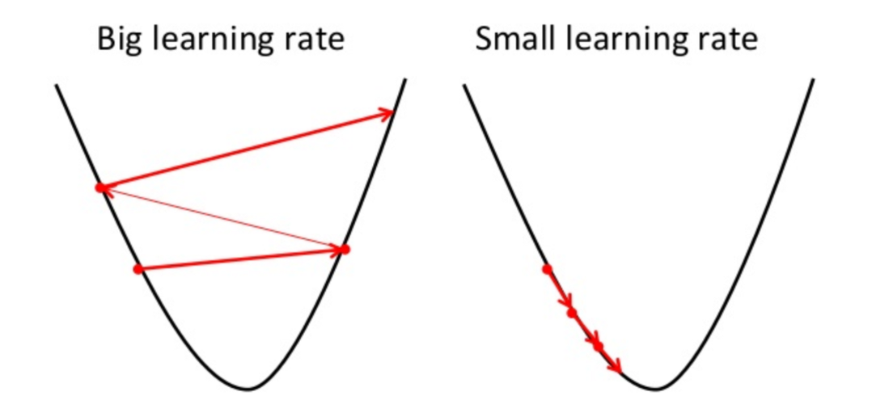
Learning rate
We need to carefully consider the hyperparameters of our machine learning models, or they will not work as intended.
Notes:
When we are optimizing our weights we often use a hyperparameter for the model, which determines something about the model itself. In the image we see a differential function representing the MSE. We take steps along this function to determine its optimum, but if we take very large steps we will overshoot the optimum. In the case of gradient descent for linear regression we can actually compute the optimal coefficients directly.

Slide 65
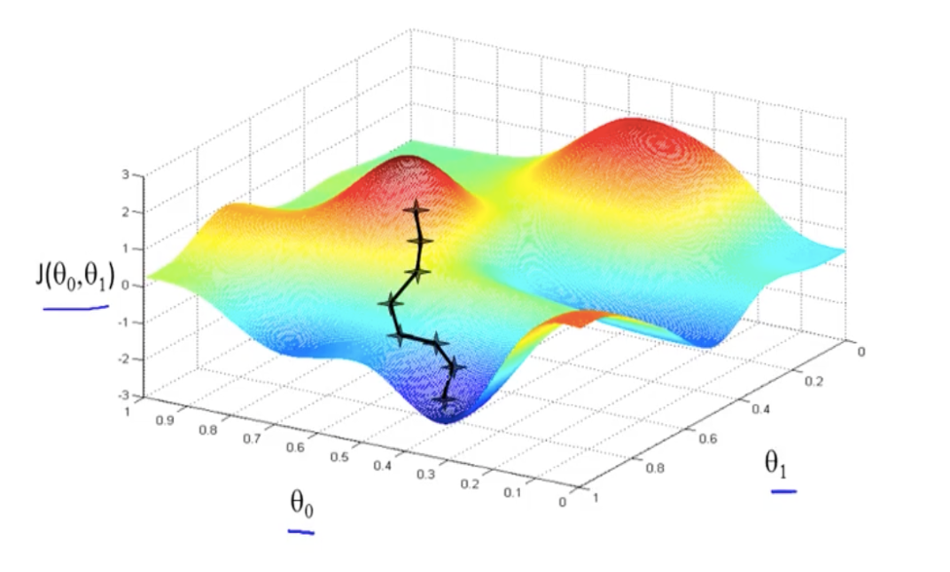
Optimalization – Gradient Descent
Notes:
In this image we see the parameter space, where J(theta0, theta1) refer to a function of two of the weight’s models. We can traverse this gradient by adjusting our weights to search for an optimal solution and we are guided by our evaluation metrics as we do so.

Slide 66
Randomized Optimalization
(random-restart) Hill Climbing
Randomized Hill Climbing (also known as stochastic hill climbing)
Simulated Annealing
Genetic Algorithm
MIMIC (Mutual-I)
Information-Maximizing Input Clustering
Notes:
https://medium.com/@mlgomez230/optimization-techniques-in-machine-learning-5d06725942b
https://deeptechbytes.com/stochastic-optimization-algorithms-a-gentle-introduction/
There are several stochastic optimizations, algorithms. Some samples of stochastic optimization algorithms include:
Iterated native Search
Stochastic Hill climb
Stochastic Gradient Descent
Tabu Search
Greedy Randomized Adaptive Search Procedure.
Some samples of stochastic optimization, algorithms that are galvanized by biological or physical processes include:
Simulated tempering
Evolution methods
Genetic formula
Differential Evolution
Particle Swarm improvement

Slide 67
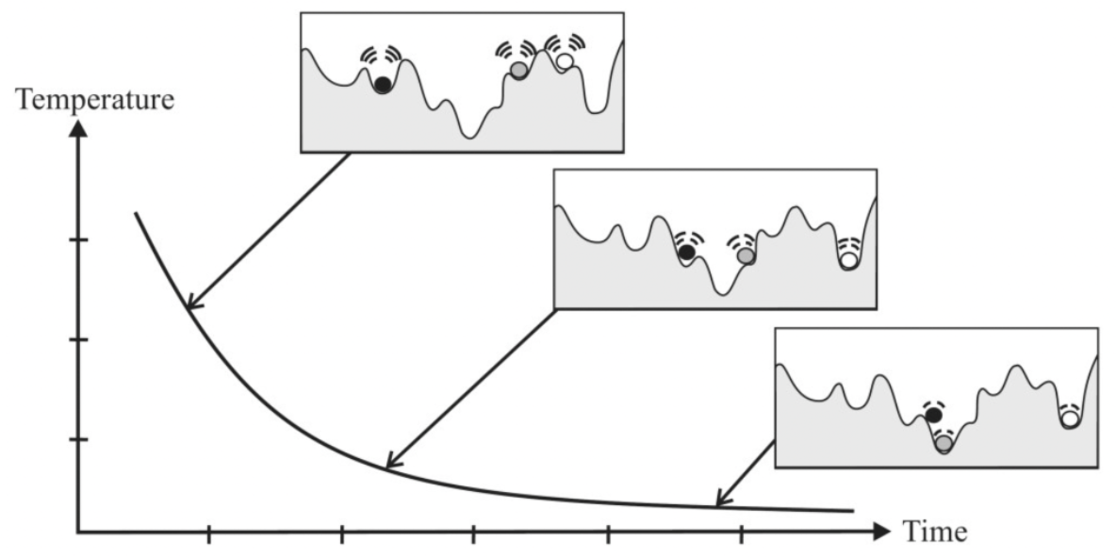
Simulated Annealing
Notes:
https://towardsdatascience.com/optimization-techniques-simulated-annealing-d6a4785a1de7
https://medium.com/analytics-vidhya/simulated-annealing-869e171e763c
The reason for Simulated Annealing to be Deprecated is not because Basin-hopping outperforms it theoretically but because the specific implementation done for Simulated Annealing in the library is a special case of the second.
If you want to use a Simulated Annealing algorithm I recomend you to use scipy.optimize.dual_annealing instead, but with ′𝑣𝑖𝑠𝑖𝑡′=𝑞𝑣=1,′𝑎𝑐𝑒𝑝𝑡′=𝑞𝑎=1′visit′=qv=1,′acept′=qa=1 (this recover Classical Simulated Annealing, i.e. the temperature decreases logarithmically). Other parameter election leads to more sophisticated Annealing processes, like ′𝑣𝑖𝑠𝑖𝑡′=𝑞𝑣=2,′𝑎𝑐𝑒𝑝𝑡′=𝑞𝑎=1′visit′=qv=2,′acept′=qa=1 (which recover the Fast Simulated Annealing, i.e. the temperature decrease up to inverse).
def simulated_annealing(func, x0, **kwargs):
scipy.optimize.dual_annealing(func, x0, visit=1, accept=1, no_local_search=True, **kwargs)

Slide 68
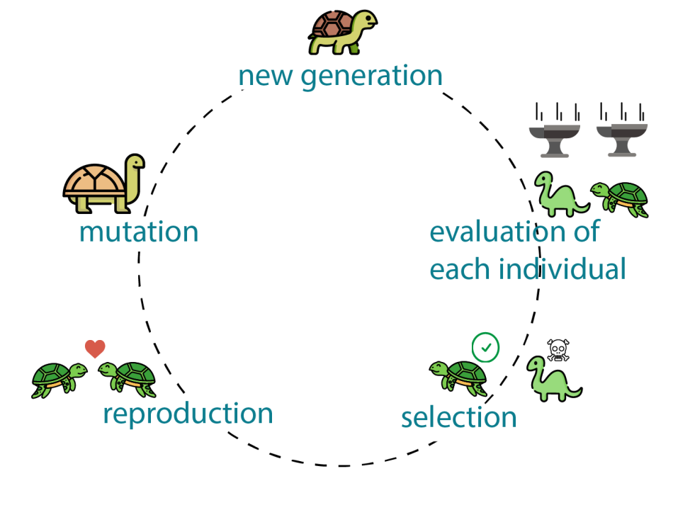
Genetic Algorithms
Algorithm that works with different models to optimise
Often uses a string representation that corresponds to a vector, tree, graph or other data structure
New algorithms are produced by combining traits from parents and mutation

Slide 69
Opdracht 3.1 – Gradient Descent
Create points along a 2-degree polynomial function
Determine the gradient function.
What is the minimum?
Build a program that starts at a random point and iterates to the maximum.
Use the gradient function.

Slide 70
Opdracht 3.2 – Hill Climbing
In the exercise a random hill landscape is created
Define a function that can find the maximum by iterating steps
A second landscape is defined
Change the function to step over the same hills.
Or use a random jump the start somewhere else.

Slide 71
Opdracht 3.4 - Getij
1. Download a dataset with tidal information for one year from: https://www.rijkswaterstaat.nl/water/waterdata-en-waterberichtgeving/waterdata/getij
2. Import it into a pandas dataframe.
3. Perform Exploratory Data Analysis (EDA).
4. Select columns with measurement moments and measurement values.
5. Convert measurement moments to datetime type.
6. Answer the following questions:
- What is the highest value of the tide level during ebb?
- What is the lowest value of the tide level during flood?
- What cycles are visible in the data? How long do they last?
7. Create a model based on a sinusoidal function:
- Use `from scipy.optimize import curve_fit` to find the optimal parameters.
- What is the duration of a cycle?
def model(x, amplitude, offset, cyclus, shift):
return amplitude * np.sin(2 * np.pi * ((x - shift) / cyclus)) + offset

Slide 72
Part 4
Classification Algorithms

Slide 73
Part 4 - Classification
Comparing Algorithms
Ensemble Methods
Evaluation Metrics

Slide 74
Classification methods
Naive Bayes
K-Nearest Neighbor
Logistic Regression
Support Vector Machines
Discriminant Analysis
Decision Trees
Random Forest
Neural Networks
Background
Variations – Metaparameters
Pro's
Con's
Application

Slide 75
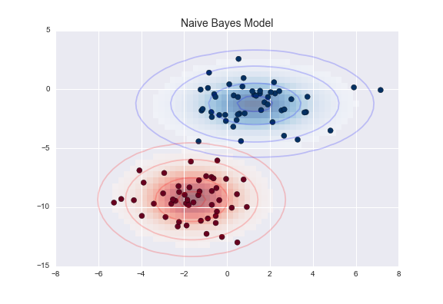
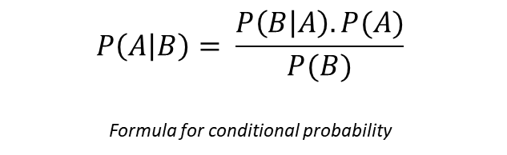
Naive Bayes
Gaussian Naive Bayes
Assumes the data is characterized by a Gaussian distribution
No covariance (independent dimensions) between the parameters
Prior probabilities are equal
Always check your assumptions
$$P\left(A | B\right)= \frac{P\left(B | A\right).P(A)}{P(B)}$$
Formula for conditional probability

Slide 76
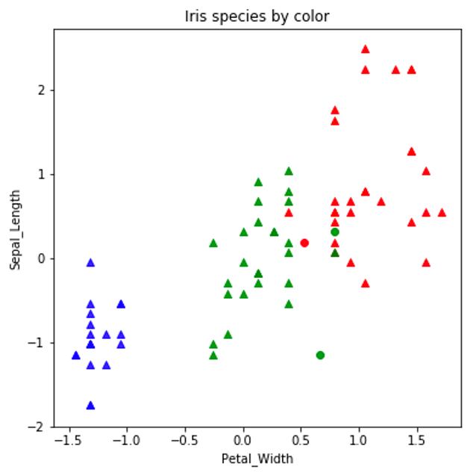
K Nearest Neighbor
Distance metric
Euclidian
City block
Scaling
min-max
z-score (standardization)
Curse of Dimensionality

Slide 77
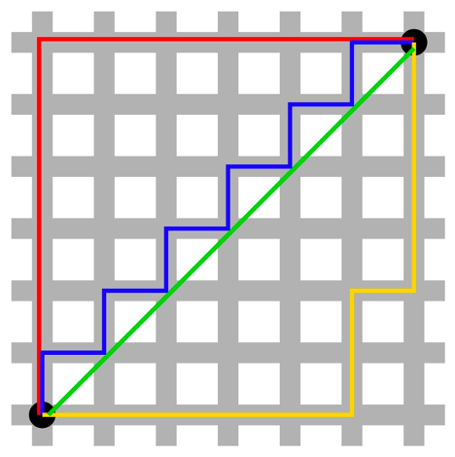
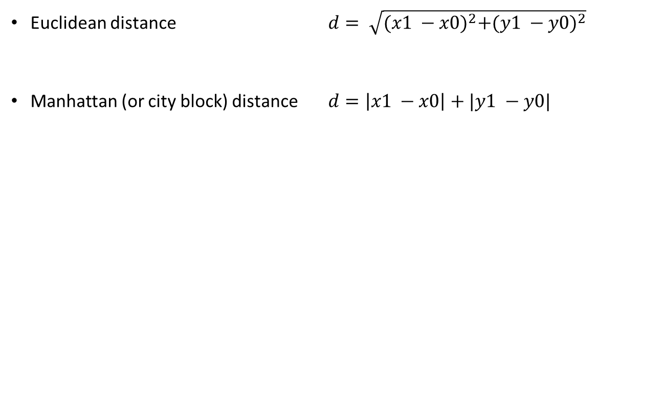
Distance metric
Euclidean distance $d= \sqrt{{(x1 −x0)}^{2}+({y1 −y0)}^{2}}$
Manhattan (or city block) distance $d=\left|x1 −x0\right|+|y1 −y0|$

Slide 78
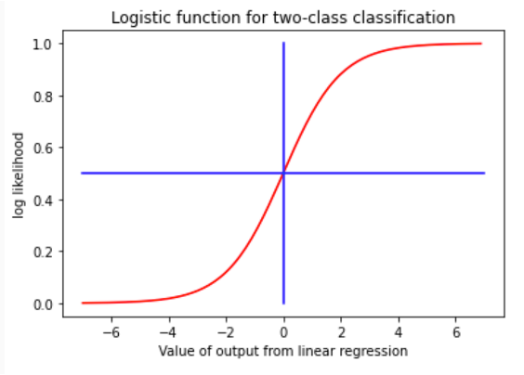
Logistic Regression
logarithmic loss

Slide 79
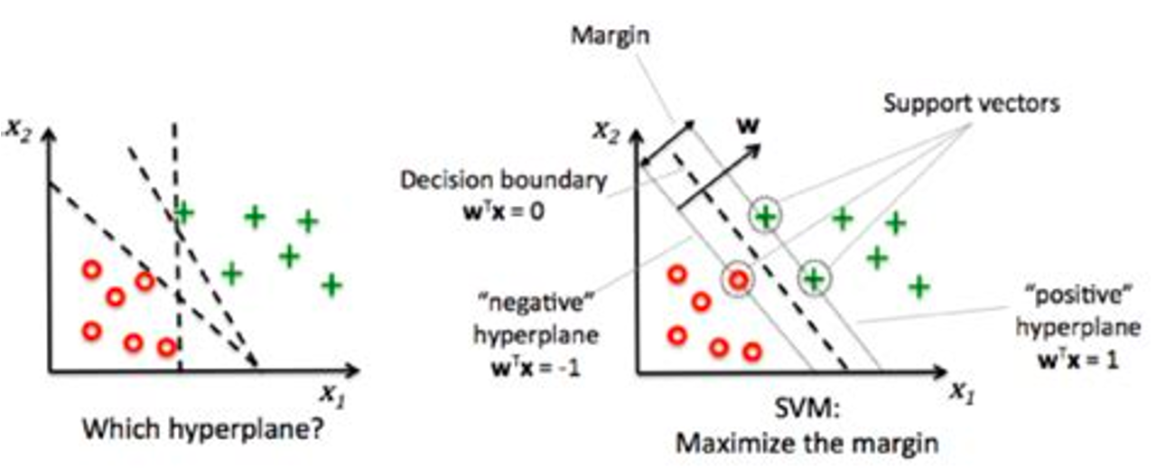
Support Vector Machine
Kernels
Linear, Polynomial, Radial

Slide 80
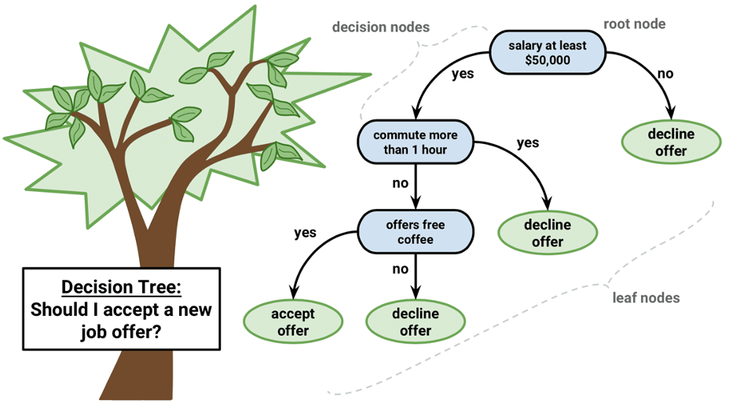
Decision Trees
Impurity
Transparancy
Variable importance
https://www.ibm.com/topics/decision-trees

Slide 81
Random Forest
Multiple Decision Trees
Ensemble method - Feature Bagging
a random subset of the features for each tree

Slide 82
Ensemble Learning
Ensemble Learning is a technique that combines predictions from multiple models to get a prediction that would be more stable and generalize better.
Notes:
https://towardsdatascience.com/catboost-vs-lightgbm-vs-xgboost-c80f40662924

Slide 83
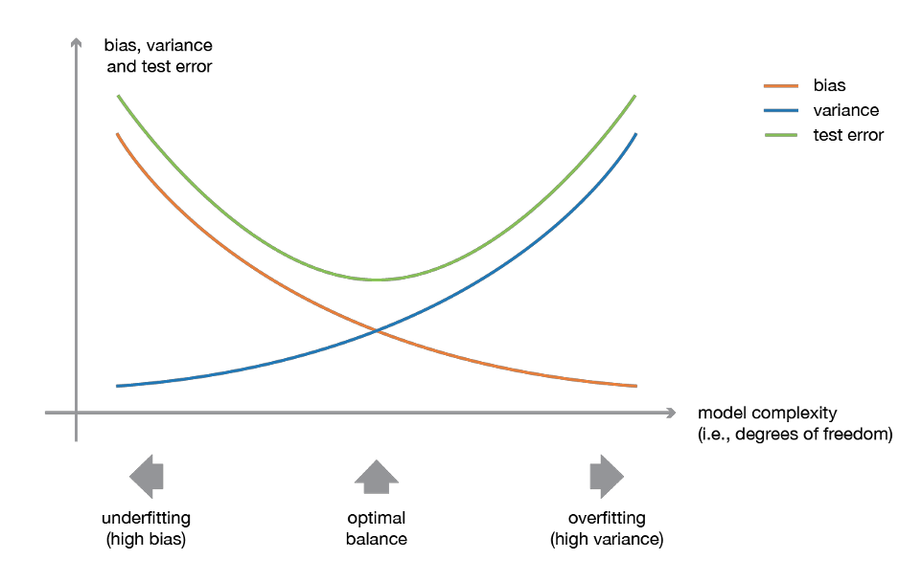
Bias Variance Tradeoff
Bias
Variance

Slide 84
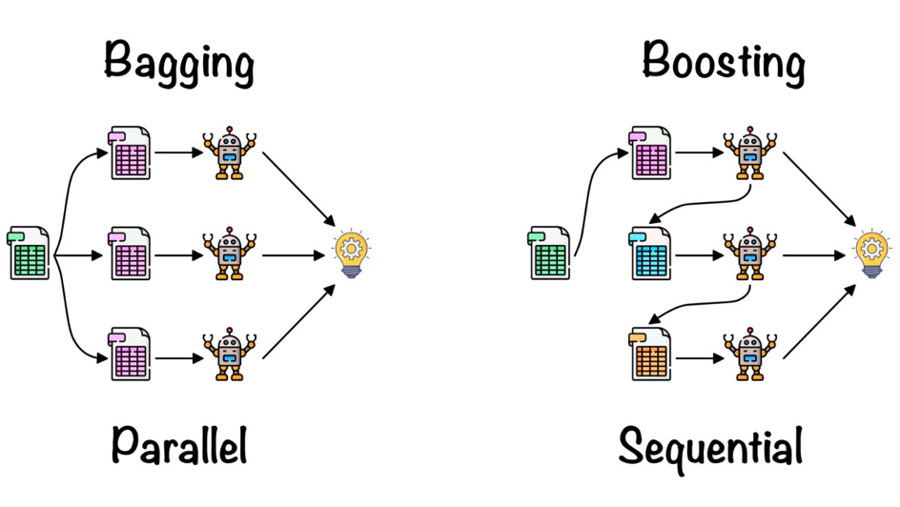
Bagging and Boosting

Slide 85
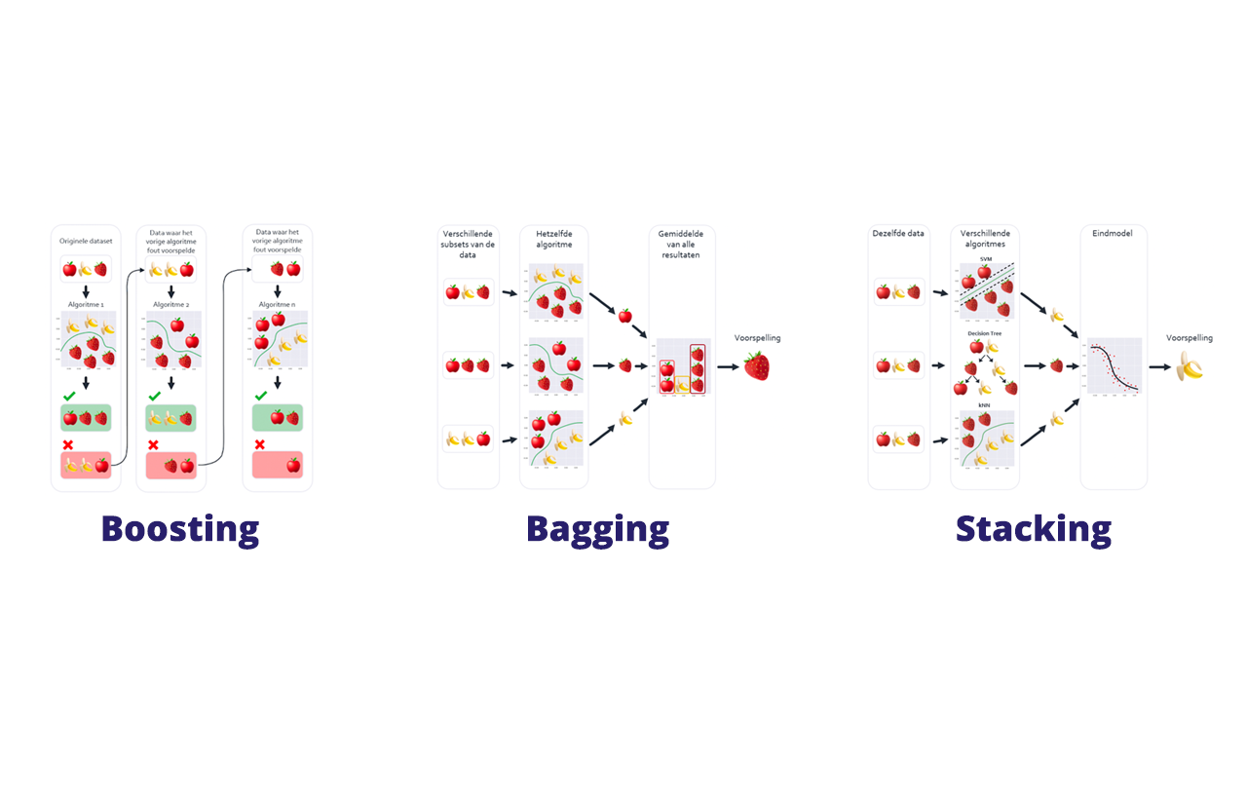
Bagging and Boosting and Stacking

Slide 86

Bagging
Bootstrap Aggregating
train on random samples with replacement
majority vote

Slide 87
Boosting
In boosting technique, the data for the training is resampled and combined in an adaptive manner such that the weights in the resampling are increased for those data points which got mis-classified more often.

Slide 88
AdaBoost
The core principle of AdaBoost is to fit a sequence of weak learners (i.e., models that are only slightly better than random guessing, such as small decision trees) on repeatedly modified versions of the data.
https://vitalflux.com/adaboost-algorithm-explained-with-python-example/
https://youtu.be/-DUxtdeCiB4

Slide 89
Gradient Boosting
CatBoost (Category Boosting),
LightGBM (Light Gradient Boosted Machine)
XGBoost (eXtreme Gradient Boosting)

Slide 90
Evaluation Measures for Classification
Confusion Matrix
Accuracy
Precision-Recall Curve
F1 Score
Area Under the ROC Curve (AUC)
Log/Cross Entropy Loss

Slide 91
Binary Classification
Confusion matrix
 | Scored Positive | Scored Negative
Actual Positive | True Positive | False Negative
Actual Negative | False Positive | True Negative

Slide 92

Type I and Type II Errors

Slide 93




Model Evaluation Measures
Confusion Matrix
Accuracy $\frac{TP+TN}{TP+TN+FP+FN}$
Precision $\frac{TP}{TP+FP}$
Recall $\frac{TP}{TP+FN}$
F1 $2 ×\frac{Precision ∗Recall}{Precision+Recall}$

Slide 94

Precision vs Recall
Precision is the measure of how many observations our model correctly predicted over the amount of correct and incorrect predictions.
Recall is the measure of how many observations our model correctly predicted over the total amount of observations.

Slide 95


F1 – Precision versus Recall
$F_{1}=2∙\frac{precision∙recall}{precision+recall}$
$F_{β}=\left(1+β^{2}\right)∙\frac{precision∙recall}{\left(β^{2}∙precision\right)+recall}$
hardloopwedstrijd 10 km <- 2 * a
5 km – 10 km/u <- $v1$
5 km – 5 km/u <- $v2$
Wat is de gemiddelde snelheid?
Totale afstand 10 km
Totale tijd 0.5 uur + 1 uur
Gemiddelde snelheid 10 km / 1.5 uur
6.7 km/u
Harmonische gemiddelde $=2∙\frac{v1∙v2}{v1+v2}$
Notes:
https://www.mikulskibartosz.name/f1-score-explained/
$\frac{2a}{\frac{a}{v1}+\frac{a}{v2}} ⟹ \frac{2}{\frac{1}{v1}+\frac{1}{v2}} ⟹ \frac{2}{\frac{v2}{v1∙v2}+\frac{v1}{v1∙v2}}$ $⟹ \frac{2∙v1∙v2}{v1+v2}$
$$F_{1}=2∙\frac{precision∙recall}{precision+recall}$$
$$F_{β}=\left(1+β^{2}\right)∙\frac{precision∙recall}{\left(β^{2}∙precision\right)+recall}$$

Slide 96

ROC en AUC

Slide 97

Classifier comparison
Notes:
https://scikit-learn.org/stable/auto_examples/classification/plot_classifier_comparison.html
https://vishalprabhukhanolkar.wordpress.com/2018/04/18/classification-methods-comparison/
https://data-flair.training/blogs/machine-learning-classification-algorithms/

Slide 98
Clustering
Clustering
Hierarchical
Clustering
Partial
Clustering
Agglomerative
Divisive
k-Means
Fuzzy C-Means
Notes:
Partition Methods
Hierarchical Methods
Density-Based Methods
Grid-Based Methods

Slide 99
Clustering
K-Means
DBSCAN
Affinity Propagation
Agglomerative Clustering
BIRCH
Mini-Batch K-Means
Mean Shift
OPTICS
Spectral Clustering
Notes:
https://medium.com/coders-mojo/day-22-60-days-of-data-science-and-machine-learning-series-752dca7af6e

Slide 100
Outlier Detection
IQR
Isolation Forest
Extended Isolation Forest
Local Outlier Factor
DBSCAN
One Class SVM
Notes:
https://machinelearninghd.com/outlier-detection-python/

Slide 101

K Means Clustering Algorithm
Choose number of expected centroids
Randomly choose centroid positions
Calculate distance between each point an the centroids
Assign point to nearest centroid
Calculate new centroids based on mean distance to assigned points

Slide 102
DBSCAN
Density-based spatial clustering of applications with noise - DBSCAN
Neighbors of the neighbor
Preset neighborhood radius and minimum number of neighbors

Slide 103
Opdracht
Download de German Credit dataset (https://archive.ics.uci.edu/ml/datasets/)
Lees in een pandas dataframe
Doe een EDA. Hoe ziet de data eruit?
Maak vertaal dictionaries voor de codes. Gebruik hiervoor de documentatie.
Gebruik map om de data leesbaar te maken.
De meeste kolommen zijn categorien. Gebruik One-hot encoding.
Maak hiervan een training en een test dataset.
Train een classificatie model
k-nearest neighbor
naive bayes
logistic regression
Kijk naar de resultaten en bepaal daarvan enkele metrics.

Slide 104
Opdracht
Lees de dataset penguins van seaborn in
Gebruik als X de features 'flipper_length_mm’ en 'body_mass_g’
Gebruik K-Means om clusters te maken.

Slide 105
Part 5
Neural Networks

Slide 106
Part 5 - Neural Networks
Multi Layer Perceptron
Backpropagation
Neural Network Architecture
Applications
Notes:
This section will introduce neural networks. We’ve seen the multilayer perceptron before in sklearn while classifying, but will delve deeper into the neural network architecture for now. We will also discuss some applications of neural networks.

Slide 107


Neural Network
Biological Neuron
Artificial Neuron
Notes:
The neural network is based on the brain. Just like our brains, a neural network consists of a number of neurons. This number can be fairly small or very large (in the case of deep learning we always have many neurons). The biological neuron has connections to other neurons, these are called axons. They are covered in a myelin sheat, which is why they are also called the myelinated axon. These translate to the connections in our neural network. However; not all connections were built equal. They all contain their own weights, which indicates how strong the connection between the two neurons is. For example, if we have a group of neurons that holds the association ‘table’, that group might be very connected with all of the neurons in the ‘chair group’. Sadly we can not view our very abstract brains in this way directly, but we do roughly know how association works in the brain.
The neurons in an artificial network are called nodes. The strength of the signal is determined by the activation function. The signal is then passed through the entire network in order to determine the output. There are many different activation functions.

Slide 108

Artificial Neural Network - ANN
Notes:
The Artificial Neural Network (or just Neural Network) consists of an input layer (with as many nodes as inputs), an output layer (with different outcomes/classifications) and one or more hidden layers. Generally when the number of layers is high we call it deep learning, which is most applications in the current year (2024).

Slide 109

MNIST dataset: ”Hello World” for NN
Ray Kurzweil, 1970’s
Developed Optical Character Recognition with Neural Networks
Still used as an example today
Try it!
http://www.ccom.ucsd.edu/~cdeotte/programs/MNIST.html
Notes:
https://en.wikipedia.org/wiki/Ray_Kurzweil The first practical application of neural networks dates back to the 1970’s, to Ray Kurzweil and his optical character recognition. The MNIST dataset is often used as a first neural network project and centers around handwritten digit recognition. It supports digits 0-9 and can be used to achieve a very high accuracy. See the link in the slides and the attached code on the website for a demo in Tensorflow and Keras.

Slide 110



Artificial Neuron - Perceptron
Notes:
The perceptron is a unit in the neural network that contains an activation function. This means the input nodes (neurons) do not count as perceptrons. Each perceptron, also called a threshold logic unit, has an activation function. Different activation function might result in having to initialize the model differently. The learning rate of the model also usually depends on other hyperparameters. When we are using a feedforward network we sometimes run into the vanishing gradients problem, where the lower layers weights are barely changed at all. While there is not one clear cause for this problem, the problem seemed to stem from a combination of the initialization and the activation function. Also see Glorot and Bengio’s 2010 research on “Understanding the Difficulty of Training Deep Feedforward Neural Networks”.

Slide 111

Backpropagation
Training involves determining weights for each input to the perceptron
Perceptron = TLU, Threshold Logic Unit
Uses a loss function that can be optimized with gradient descent
Backpropagation provides backward feedback to weights in the previous layers
Feed-Forward
Backpropagation
Notes:
Backpropagation also provides feedback backwards.

Slide 112

Machine vs. Human
Hard for humans:
Large calculations
Executing repetitive tasks reliably
Detecting patterns in numbers
Hard for machines:
Speech recognition & synthesis
Working with many degrees of freedom in movement
Humor, creativity, soul?
Emotions

Slide 113

Training a deep learning algorithm
Training a deep learning algorithm involves the following steps
Building a data pipeline (for example sklearn preprocessing)
Building a network architecture
Evaluating the architecture using a loss function
Optimizing the network architecture weights using an optimization algorithm

Slide 114
Opdracht
Maak een Multilayer Perceptron Classifier voor de MNST data
# Imports for machine learning
from sklearn.datasets import load_digits
from sklearn.model_selection import train_test_split
from sklearn.neural_network import MLPClassifier
from sklearn.metrics import accuracy_score, confusion_matrix

Slide 115
Neural Network Architectures
Convolutional Neural Network – CNN
Recurrent Neural Network - RNN

Slide 116


Convolutional Neural Network
Key differences:
Convolutional layers
Pooling layers
Is the context any different than long features of vectors?

Slide 117

Recurrent Neural Network

Slide 118

Keras & Tensorflow
TensorFlow
Open source deep learning from Google
Dataflow programing
Built to run on (multiple) CPU/GPU’s
Wrappers in several languages like Python, C++ and Java
Keras
Open source deep learning that became part of Tensorflow
Modular, fast and easy to use
Developed by Google Engineer François Chollet

Slide 119

PyTorch
PyTorch
Open source machine learning framework
Based on the Torch library
Used for applications such as computer vision and natural language processing
Primarily developed by Facebook's AI Research lab (FAIR)

Slide 120
Keras
Layers
Core layers Dense output = activation( dot(input, kernel) + bias )
Convolution layers Convolution2D spatial convolution over images
Pooling layers MaxPooling2D takes the maximum value over an pool window
Recurrent layers
Preprocessing layers
Normalization layers
Regularization layers
Attention layers
Reshaping layers
Merging layers
Locally-connected layers
Activation layers

Slide 121
LeNet5
Notes:
https://en.wikipedia.org/wiki/LeNet

Slide 122
Opdracht
Build a Neural Network with Keras to predict the category of the Fashion MNIST dataset.
Load the FashionMNIST daatset
Explore the dataset - EDA
Split in Training and Test dataset
Build a neural network with Keras, with correct output layer
Evaluate the results
https://playground.tensorflow.org/

Slide 123

Other Python Libraries
PyCaret
Statsmodels

Slide 124
MLaaS
Machine Learning as a Service
Microsoft Azure Machine Learning
Google Cloud Machine Learning Engine
AWS Machine Learning
IBM Watson Machine Learning

Slide 125
No-code Machine Learning
BigML
Create ML
Data Robot
Fritz AI
Google Cloud AutoML
Google ML Kit
MakeML
Microsoft Azure Automated Machine Learning
Obviously AI
RunawayML
SuperAnnotate
Teachable Machine
RapidMiner

Slide 126

Azure Machine Learning Studio
A service for end-to-end machine learning lifcycle
Notes:
https://ml.azure.com/selectWorkspace?tid=c03c789c-9f3c-454e-9f9a-c0ce7e9db70b

Slide 127

RapidMiner

Slide 128

Online learning
Notes:
Online learning is another technique that can be applied to speed up the process, as well as batch learning. The machine learning toolkit is very diverse, which means we can develop very specific applications if we know our needs.

Slide 129

Part 6 - Reinforcement Learning

Slide 130

Tic Tac Toe

Slide 131

Policy
Welke actie is het beste voor elke state?
Markov chains

Slide 132

Policy
Exploration vs Exploitation

Slide 133
Algorithms
Q-Learning
Monte Carlo
Deep Q Network
Notes:
https://neptune.ai/blog/reinforcement-learning-basics-markov-chain-tree-search

Slide 134
Opdracht
Multi-Armed Bandits
n_arms = 3
arms = [{'mu': random.randint(100,5000), 'sigma’: random.uniform(10,100)} for _ in range(n_arms)]
# GET REWARD FROM A SELECTED ARM IN YOUR TRIALS
arm_idx = 0
reward = np.random.normal(arms[arm_idx]['mu'],arms[arm_idx]['sigma']
Algorithm of Epsilon-Greedy
Initialize the estimated values of all arms to zero or a small positive number.
For each trial:
Generate a random number between 0 and 1
If the number is less than ϵ, select a random arm (exploration).
Otherwise, select the arm with the highest estimated reward (exploitation).
Update the estimated reward of the selected arm based on the observed reward.

Slide 135
Fair AI
Fairness

Slide 136
Explainable AI
White Box Models
Ad-hoc explanations
Explainability Methods
Post-hoc Feature Importance
LIME – Local Interpretable Model-agnostic Explanations
SHAP - SHapley Additive exPlanations
LOCO - Leave One Covariate Out
Bias Detection

Slide 137
Data Sets
CBS
NL Overheid
WorldBank
Kaggle
OECD Better Life Index - https://stats.oecd.org/index.aspx?DataSetCode=BLI
IMF - https://www.imf.org/en/Data
Notes:
The book also offers a great selection of sources.

Slide 138
Open Data Sources
Popular open data repositories
UC Irvine Machine Learning Repository
Kaggle datasets
Amazon’s AWS datasets
Meta portals (they list open data repositories)
Data Portals
OpenDataMonitor
Quandl
Other pages listing many popular open data repositories
Wikipedia’s list of Machine Learning datasets
Quora.com
The datasets subreddit

Slide 139
Links
TensorFlow Neural Network Playground - https://playground.tensorflow.org
Hide and Seek - https://youtu.be/kopoLzvh5jY
Coast Runners AI - https://youtu.be/O5xeyoRL95U?t=1198
MNIST Digit Recognizer - http://www.ccom.ucsd.edu/~cdeotte/programs/MNIST.html

